Slide 1
Unit 1
Comprehension 1
Dealing with stress

Slide 2
Part A
Part B
Part C
CONTENTS

Slide 3
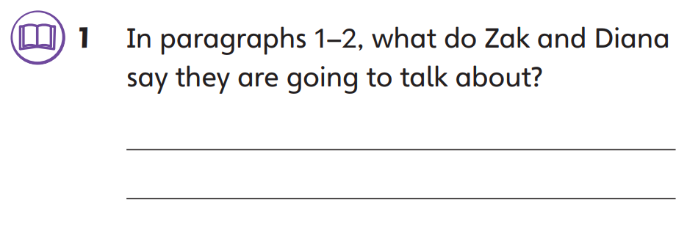
Part A
Part A
Part B
Part C

Slide 4
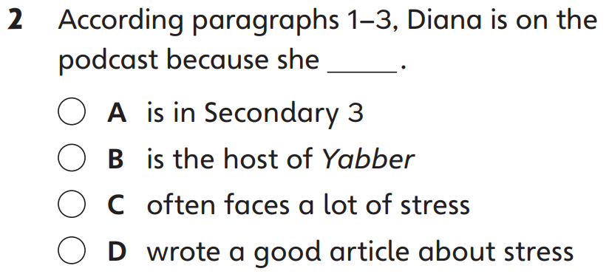
Part A
Part A
Part B
Part C

Slide 5
Part A
Part A
Part B
Part C

Slide 6
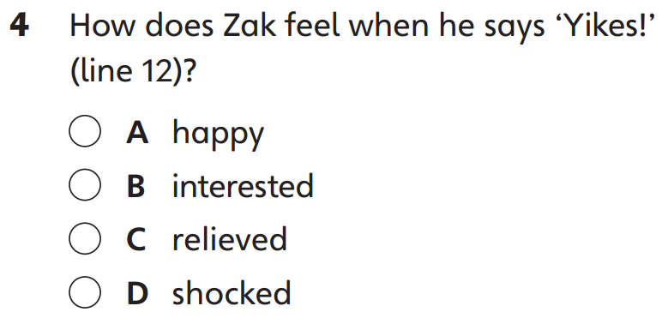
Part A
Part A
Part B
Part C

Slide 7
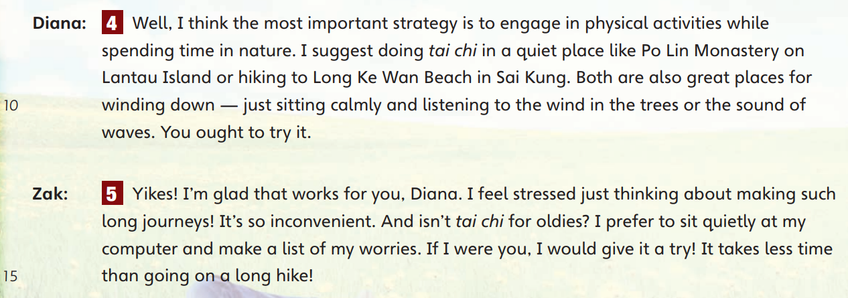
Part A
Part A
Part B
Part C

Slide 8
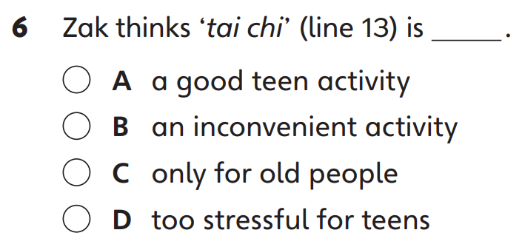
Part A
Part A
Part B
Part C

Slide 9
Part A
Part A
Part B
Part C

Slide 10
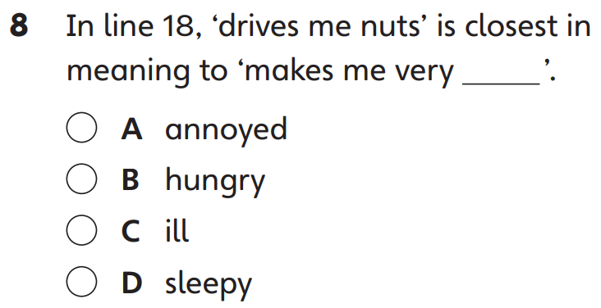
Part A
Part A
Part B
Part C

Slide 11
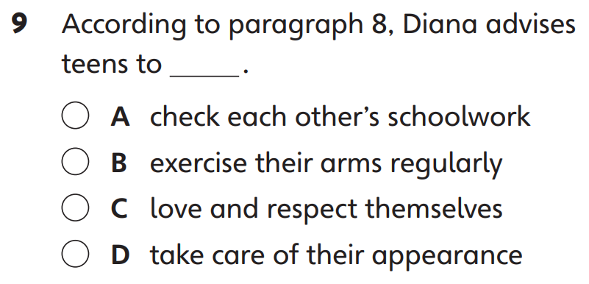
Part A
Part A
Part B
Part C

Slide 12
Part B
Part A
Part B
Part C

Slide 13
Part B
Part A
Part B
Part C

Slide 14
Part B
Part A
Part B
Part C

Slide 15
Part B
Part A
Part B
Part C

Slide 16
Part B
Part A
Part B
Part C

Slide 17
Part B
Part A
Part B
Part C

Slide 18
Part B
Part A
Part B
Part C

Slide 19
Part B
Part A
Part B
Part C

Slide 20
Part C
Part A
Part B
Part C

Slide 21
Part C
Part A
Part B
Part C

Slide 22
Part C
Part A
Part B
Part C

Slide 23
Part C
Part A
Part B
Part C

Slide 24
Part C
Part A
Part B
Part C

Slide 25
Part C
Part A
Part B
Part C

Slide 27
Acknowledgments
We are grateful to the following for permission to reproduce copyright photographs:
LeManna. Shutterstock
Every effort has been made to trace copyright, but in the event of any accidental infringement, we shall be pleased to come to a suitable arrangement with the rightful owner.

