Slide 1
Unit 2
Comprehension 2
Dear Editor …

Slide 2
Part A
Part B
Part C
CONTENTS

Slide 3
Part A
Part A
Part B
Part C

Slide 4
Part A
Part A
Part B
Part C

Slide 5
Part A
Part A
Part B
Part C

Slide 6
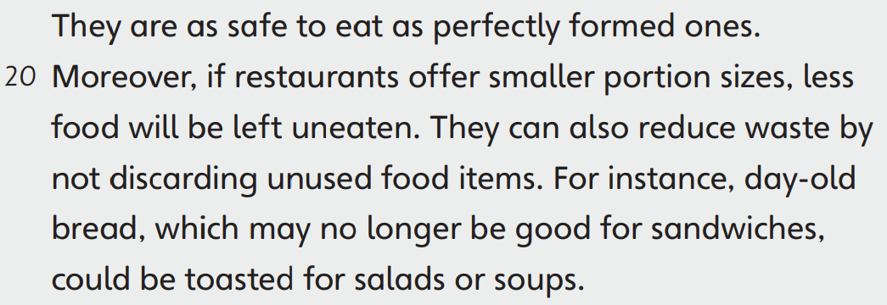
Part A
Part A
Part B
Part C

Slide 7
Part A
Part A
Part B
Part C

Slide 8
Part A
Part A
Part B
Part C

Slide 9
Part A
Part A
Part B
Part C

Slide 10
Part A
Part A
Part B
Part C

Slide 11
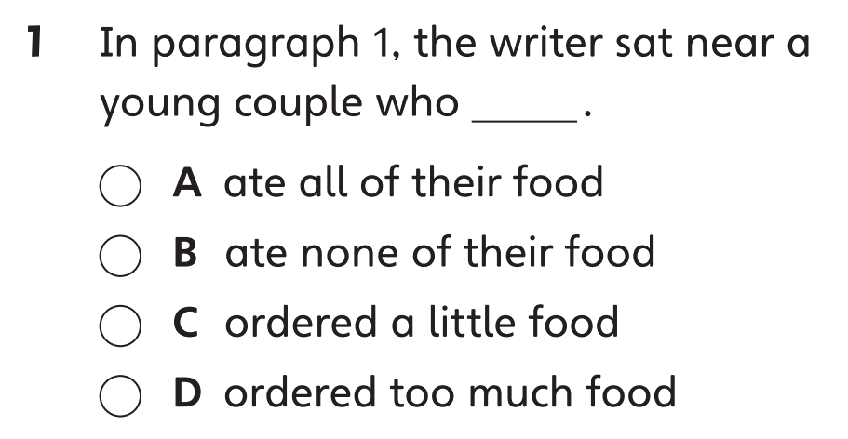
Part B
Part A
Part B
Part C

Slide 12
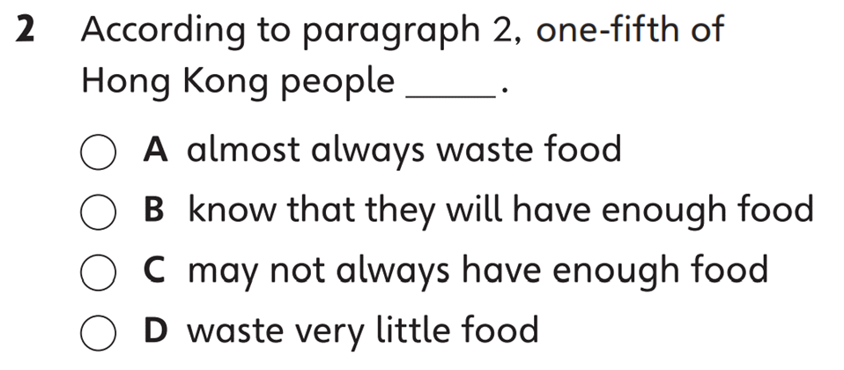
Part B
Part A
Part B
Part C

Slide 13
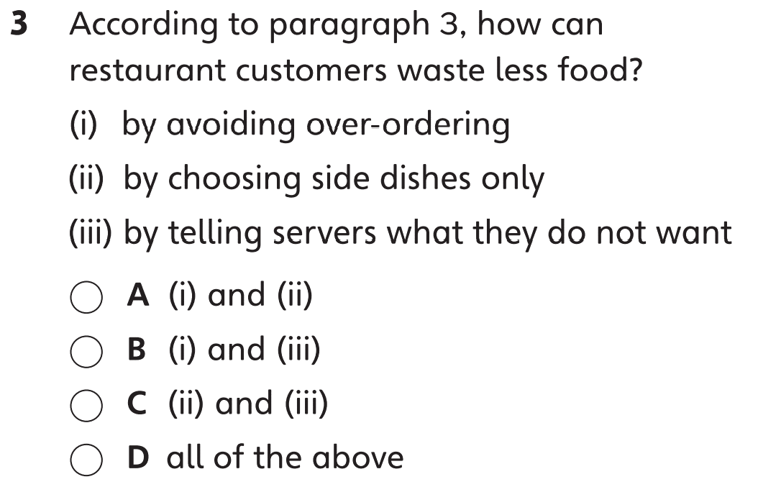
Part B
Part A
Part B
Part C

Slide 14
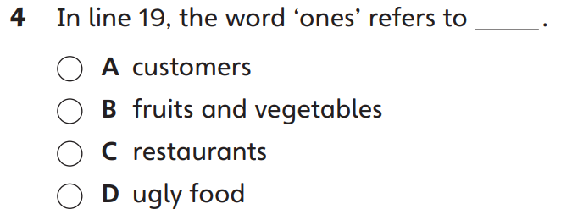
Part B
Part A
Part B
Part C

Slide 15
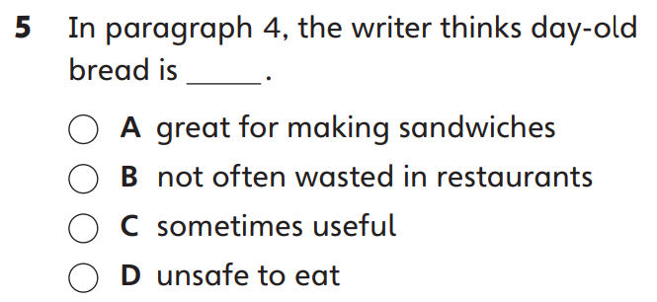
Part B
Part A
Part B
Part C

Slide 16
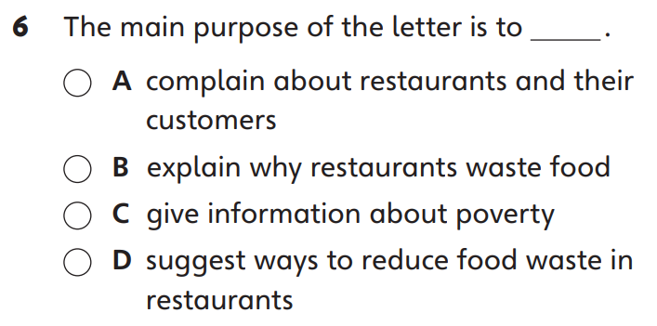
Part B
Part A
Part B
Part C

Slide 17
Part C
Part A
Part B
Part C

Slide 18
Part C
Part A
Part B
Part C

Slide 19
Part C
Part A
Part B
Part C

Slide 20
Part C
Part A
Part B
Part C

Slide 22
Acknowledgments
We are grateful to the following for permission to reproduce copyright photographs:
ultraMarin_a. Shutterstock
Every effort has been made to trace copyright, but in the event of any accidental infringement, we shall be pleased to come to a suitable arrangement with the rightful owner.

