Slide 1
Unit 2
Comprehension 1
Let’s recycle more carefully

Slide 2
Part A
Part B
Part C
CONTENTS

Slide 3
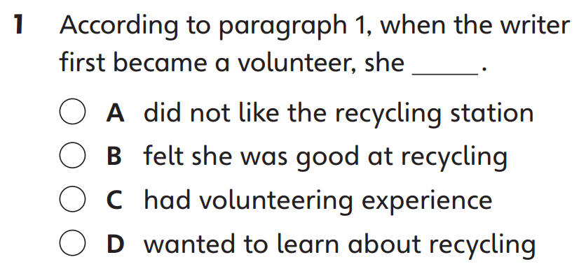
Part A
Part A
Part B
Part C

Slide 4
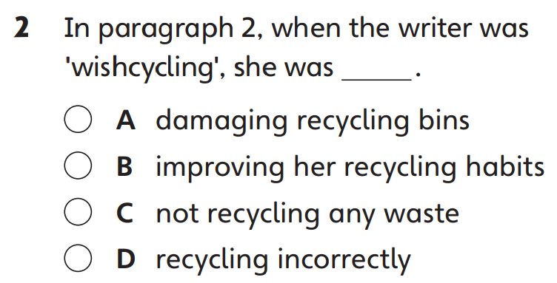
Part A
Part A
Part B
Part C

Slide 5
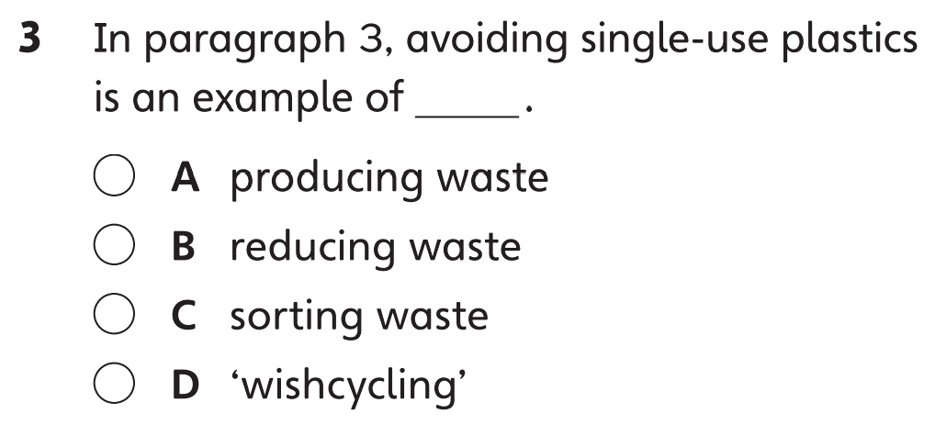
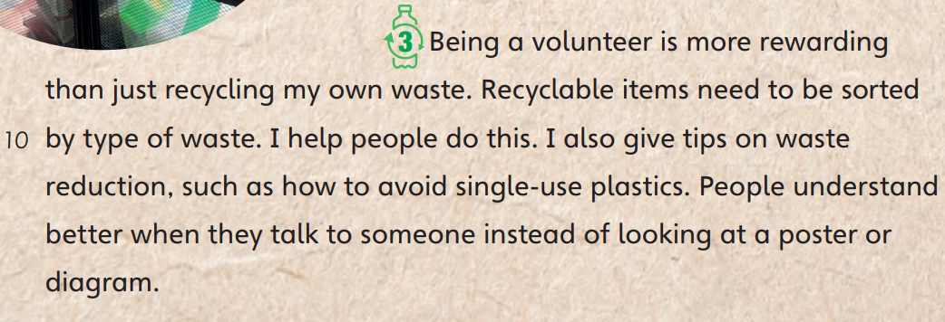
Part A
Part A
Part B
Part C

Slide 6
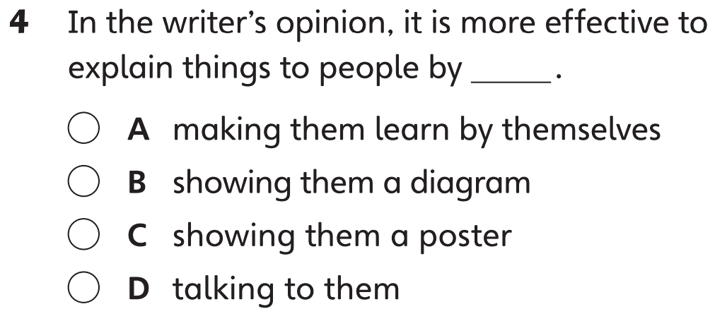
Part A
Part A
Part B
Part C

Slide 7
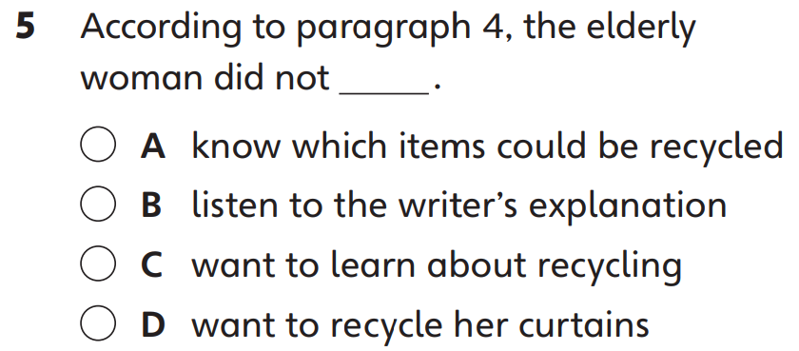
Part A
Part A
Part B
Part C

Slide 8
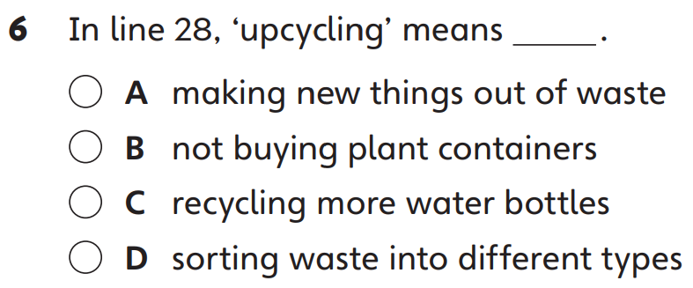
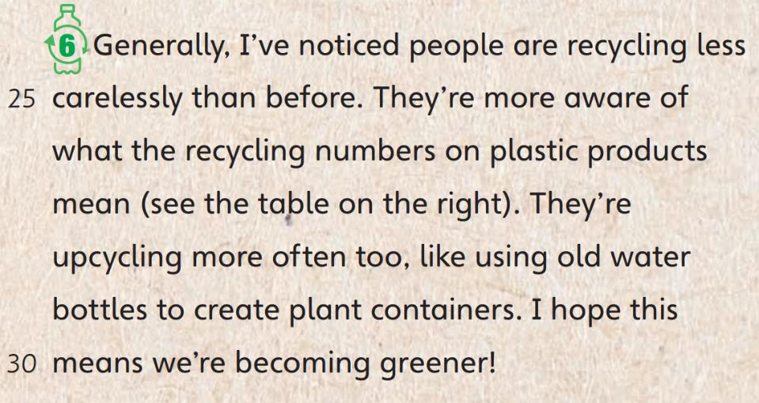
Part A
Part A
Part B
Part C

Slide 9
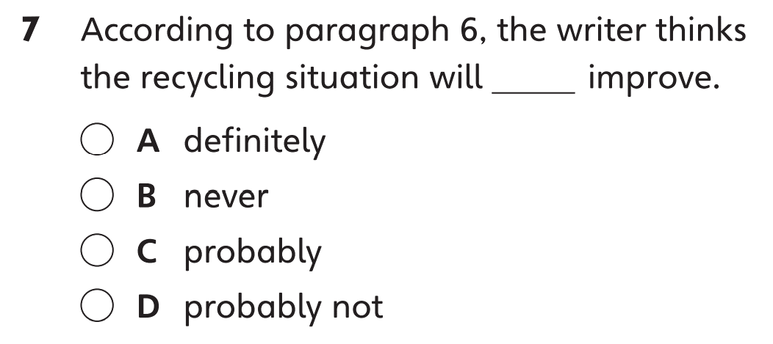
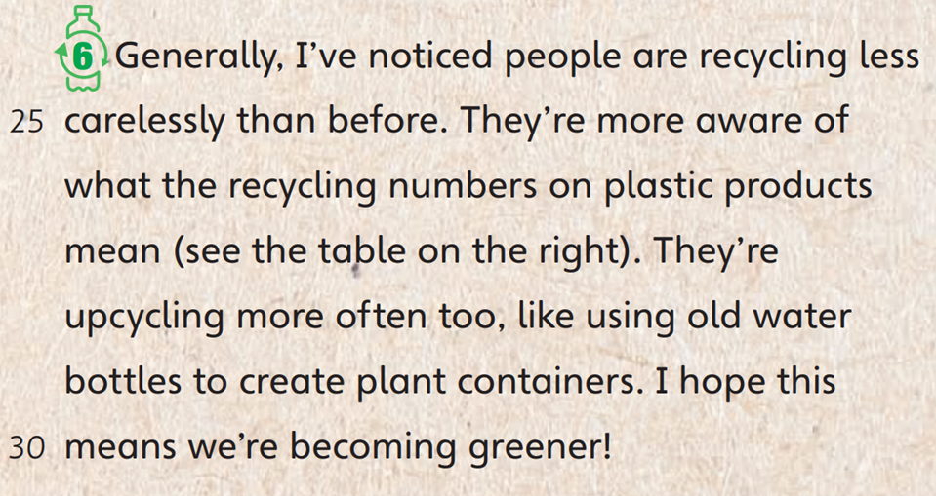
Part A
Part A
Part B
Part C

Slide 10
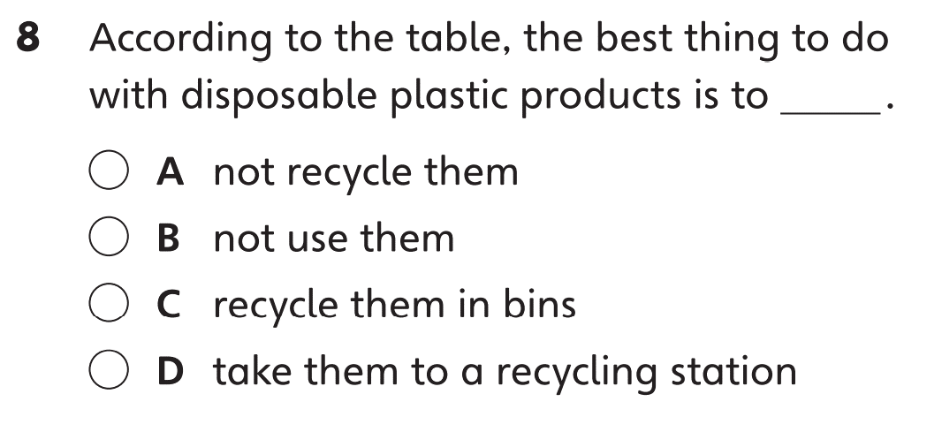
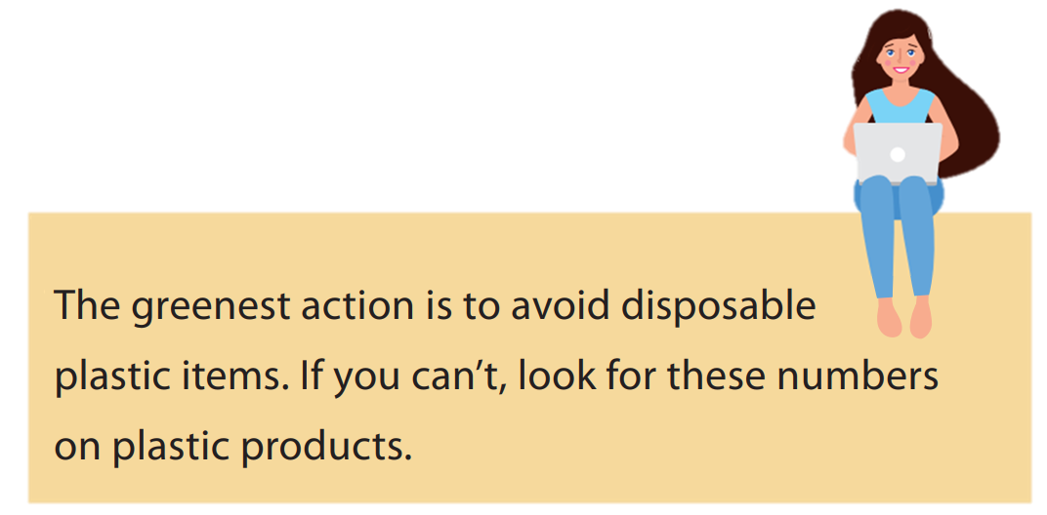
Part A
Part A
Part B
Part C

Slide 11
Part B
Part A
Part B
Part C

Slide 12
Part B
Part A
Part B
Part C

Slide 13
Part B
Part A
Part B
Part C

Slide 14
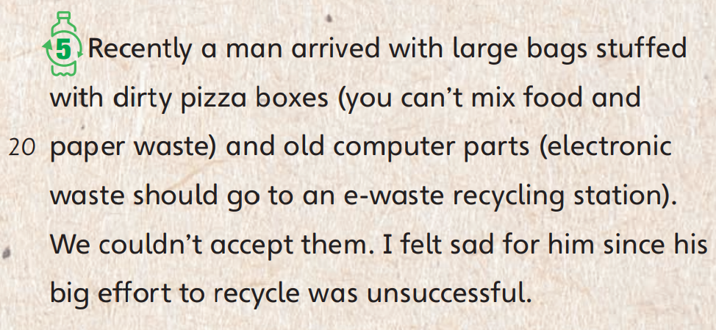
Part B
Part A
Part B
Part C

Slide 15
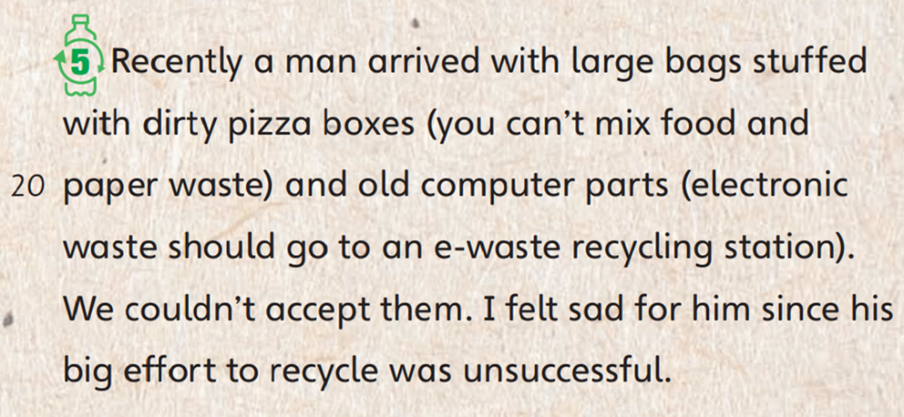
Part B
Part A
Part B
Part C

Slide 16
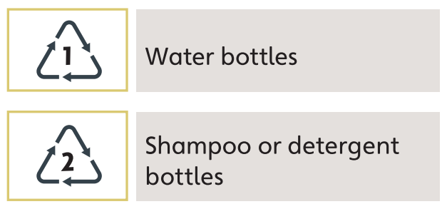
Part B
Part A
Part B
Part C

Slide 17
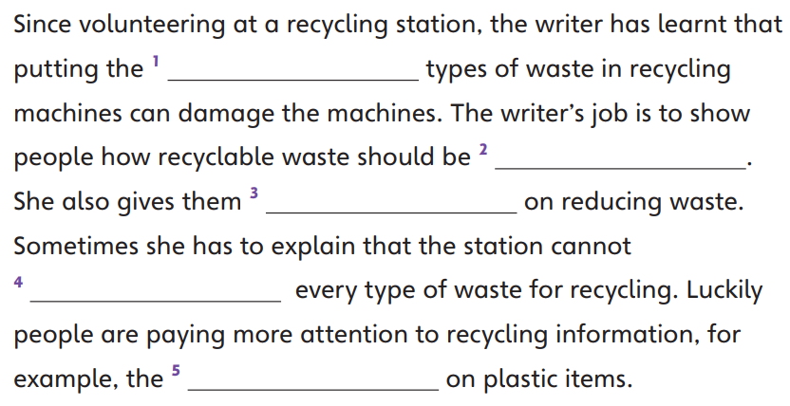
Part C
Part A
Part B
Part C

Slide 18
Part C
Part A
Part B
Part C

Slide 19
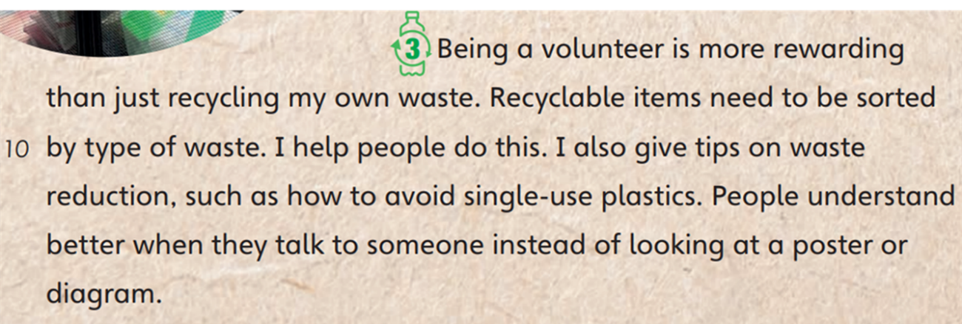
Part C
Part A
Part B
Part C

Slide 20
Part C
Part A
Part B
Part C

Slide 21
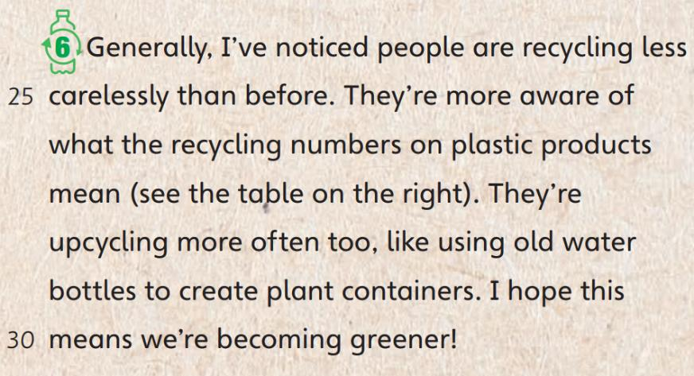
Part C
Part A
Part B
Part C

Slide 23
Acknowledgments
We are grateful to the following for permission to reproduce copyright photographs:
Anatoliy Sadovskiy. Shutterstock
aopsan. Shutterstock
Chones. Shutterstock
Gapeeva Anastasiia. Shutterstock
Rolling Stones. Shutterstock
Every effort has been made to trace copyright, but in the event of any accidental infringement, we shall be pleased to come to a suitable arrangement with the rightful owner.

