Slide 1
Unit 2
Comprehension 1
My tiny world

Slide 2
Part A
Part B
Part C
CONTENTS

Slide 3
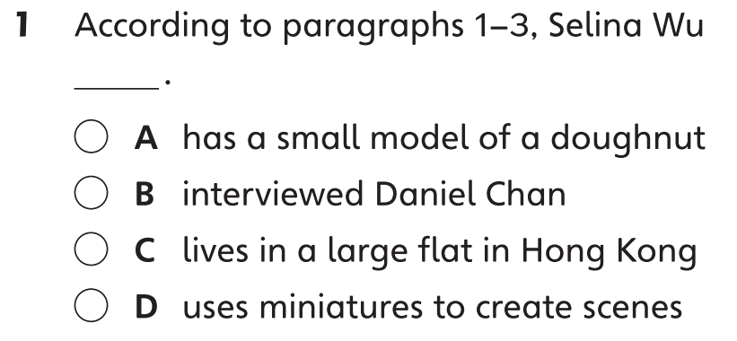
Part A
Part A
Part B
Part C

Slide 4
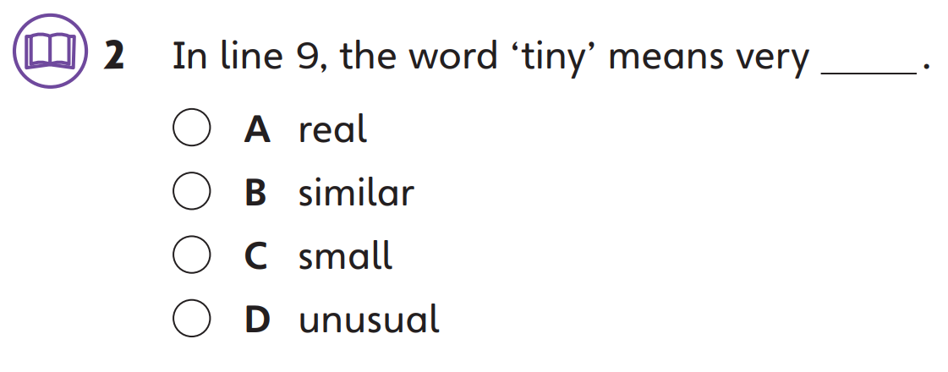
Part A
Part A
Part B
Part C

Slide 5
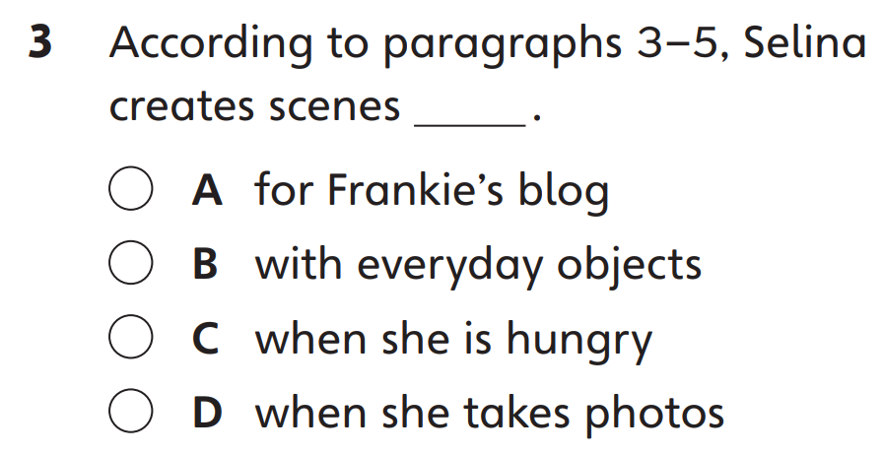
Part A
Part A
Part B
Part C

Slide 6
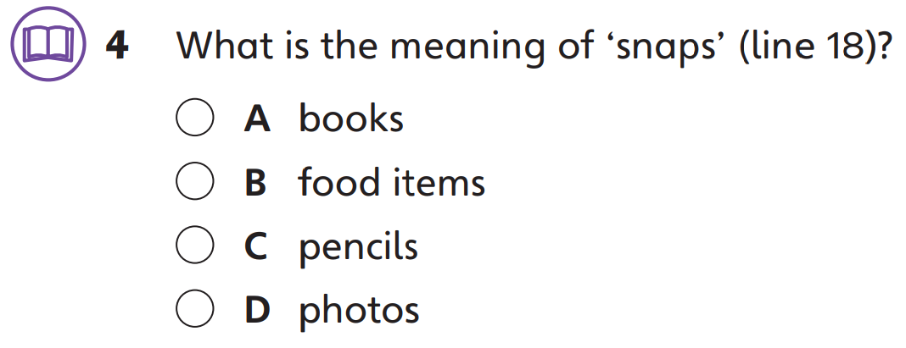
Part A
Part A
Part B
Part C

Slide 7
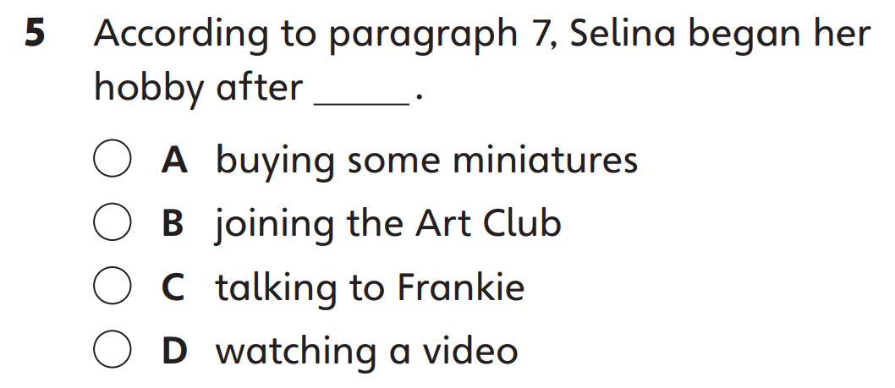
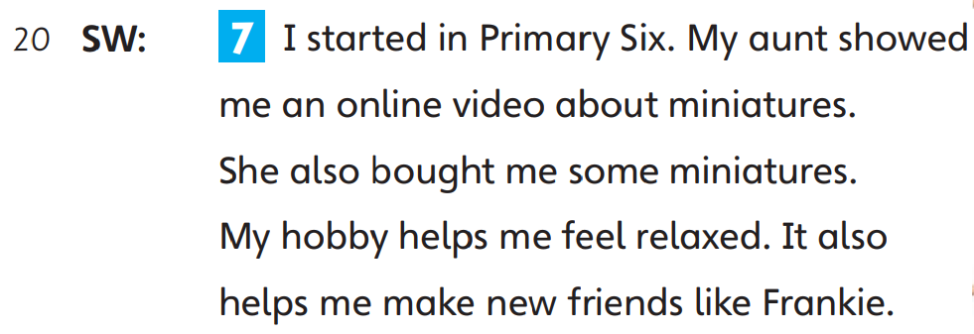
Part A
Part A
Part B
Part C

Slide 8
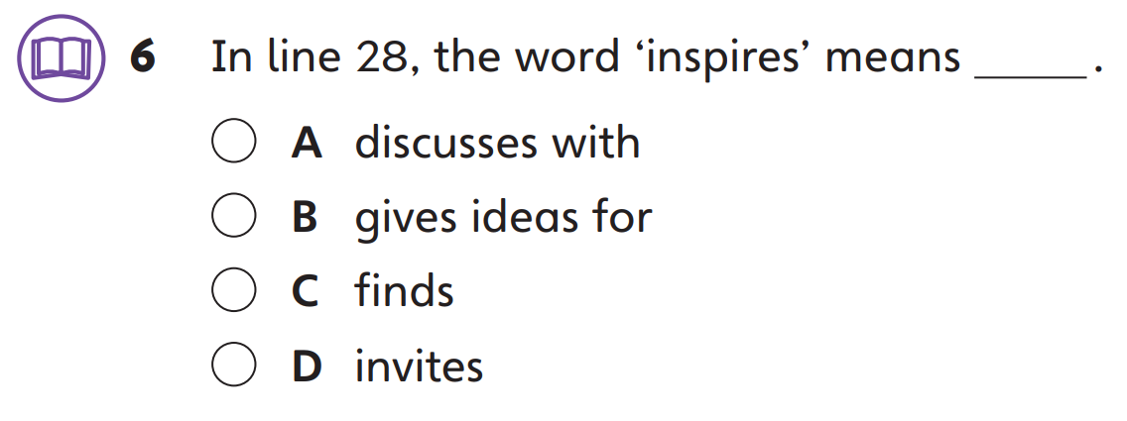
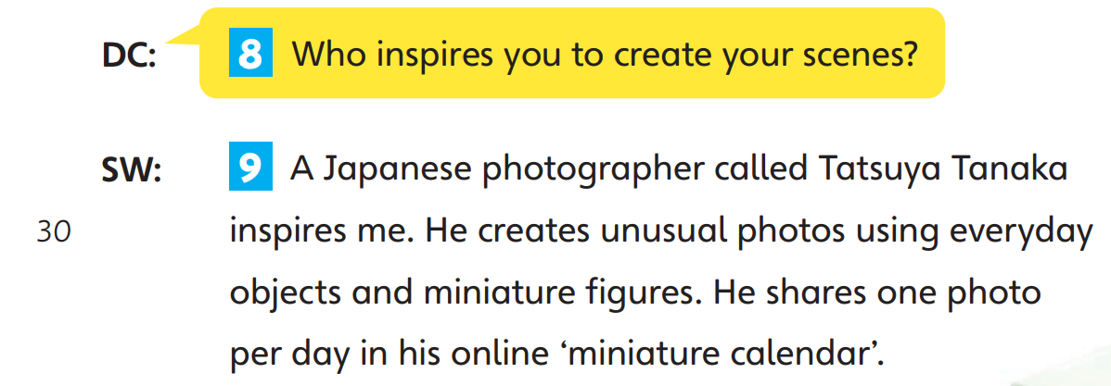
Part A
Part A
Part B
Part C

Slide 9
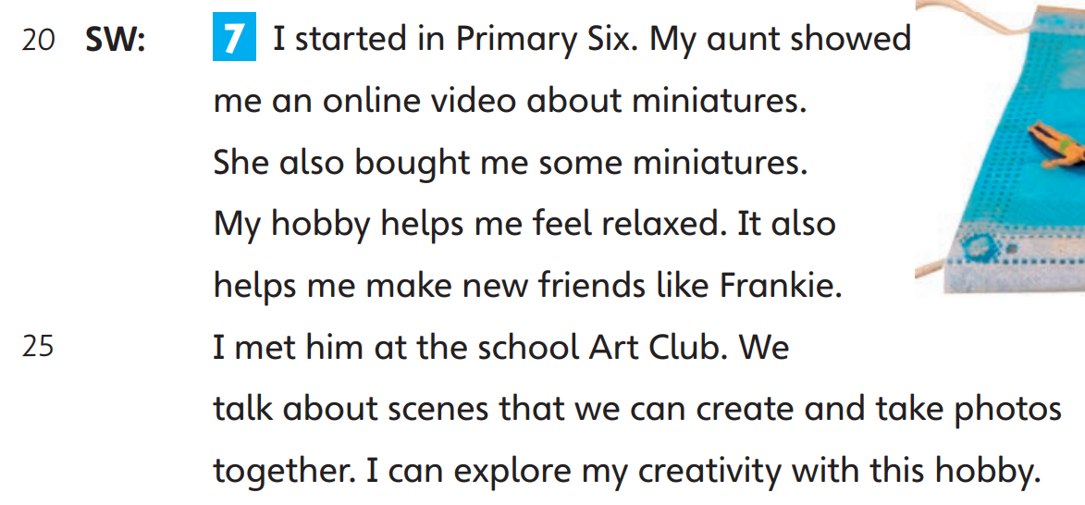
Part B
Part A
Part B
Part C

Slide 10
Part B
Part A
Part B
Part C

Slide 11
Part B
Part A
Part B
Part C

Slide 12
Part B
Part A
Part B
Part C

Slide 13
Part B
Part A
Part B
Part C

Slide 14
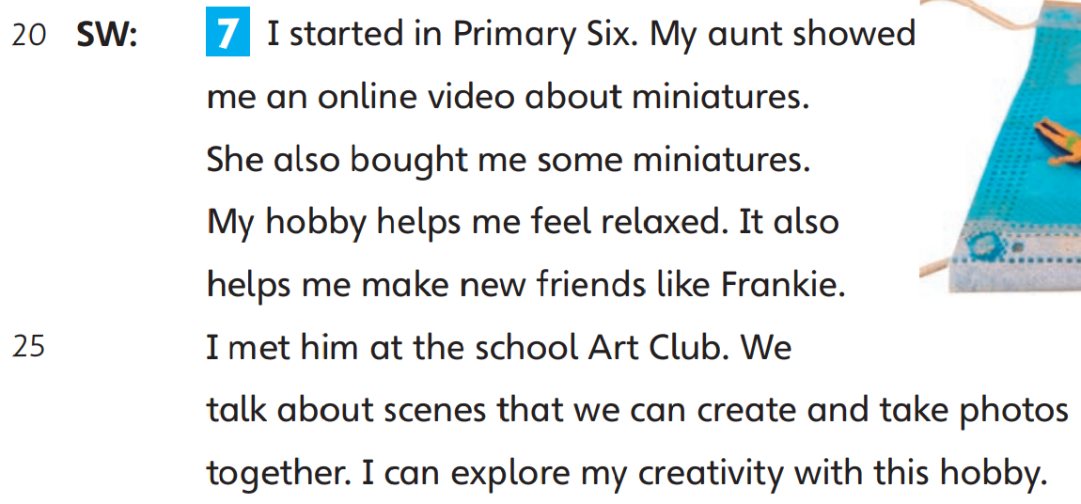
Part B
Part A
Part B
Part C

Slide 15
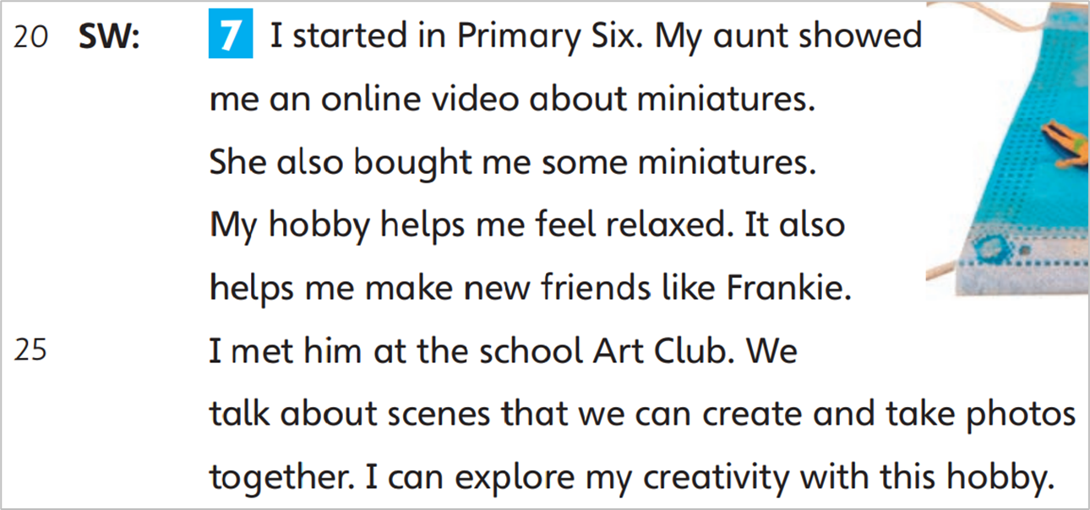
Part B
Part A
Part B
Part C

Slide 16
Part B
Part A
Part B
Part C

Slide 17
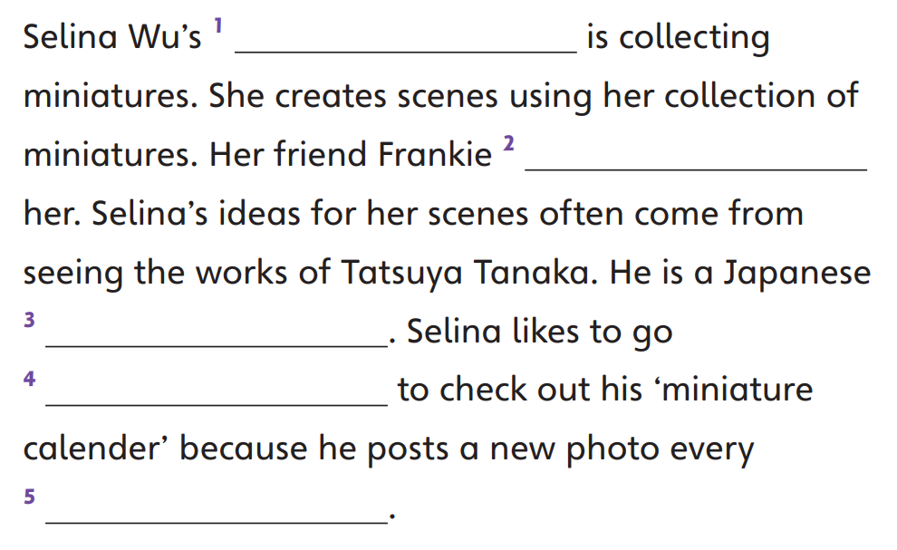
Part C
Part A
Part B
Part C

Slide 18
Part C
Part A
Part B
Part C

Slide 19
Part C
Part A
Part B
Part C

Slide 20
Part C
Part A
Part B
Part C

Slide 21
Part C
Part A
Part B
Part C

Slide 23
Acknowledgments
We are grateful to the following for permission to reproduce copyright photographs:
Mallika Home Studio. Shutterstock
SHarms. Shutterstock
Every effort has been made to trace copyright, but in the event of any accidental infringement, we shall be pleased to come to a suitable arrangement with the rightful owner.

