Slide 1
Unit 1
Making suggestions (I)

Slide 2
Making suggestions (I)
In a discussion, we may need to make suggestions. We should make sure the ideas we give add something new to the discussion, rather than simply repeat what someone else has said. We can use different expressions to make suggestions.
Pay attention to the form of the verb after each expression!

Slide 3
Examples:
Let’s collect opinions from the students and see what they think about the idea.
I suggest organising a Positive Thinking Week.
What about starting an agony aunt column on our school website?
Perhaps we should invite the school social worker to give a talk on stress management skills.
Why don’t we consult the principal first?

Slide 4
Read the following poster about Positive Thinking Day.

Slide 5
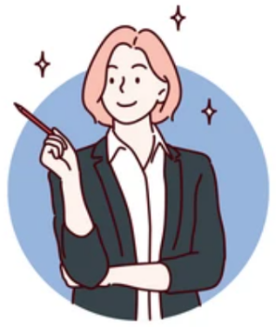
Now work in groups of four. Based on the poster’s ideas, take turns in making a suggestion about how to celebrate Positive Thinking Day. You can also add other ideas.

Slide 6
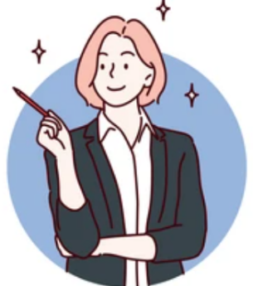
You can make suggestions like this:
Perhaps all of us should start the day by saying something positive, like ‘Today is going to be a good day’.
Why don't we try an act of kindness? I suggest making some cookies to give to the school office staff.
Additional ideas:
show gratitude for the simplest things in life
do a session of laughter yoga
keep smiling

Slide 8
Acknowledgments
We are grateful to the following for permission to reproduce copyright photographs:
autumnn. Shutterstock
belchonock. 123rf.com
Cosmic_Design. Shutterstock
Faberr Ink. Shutterstock
Incomible. Shutterstock
Roman Martseniuk. Shutterstock
Stmool. Shutterstock
Every effort has been made to trace copyright, but in the event of any accidental infringement, we shall be pleased to come to a suitable arrangement with the rightful owner.

