Slide 1
Unit 1
Language 2
Talking about imaginary situations (Type 2 conditional sentences)

Slide 2
Introduction
Imaginary situations
Type 2 conditional sentences
Giving advice
Let’s practise!
How is the grammar used?
CONTENTS

Slide 3
Helen is thinking.
Read the sentences and find out how we talk about imaginary situations.
Back to Contents

Slide 4
If I lived in Singapore, I would go to Universal Studios every weekend.
I would buy a big house for my parents if I won the lottery.
If I had an elder sister, I would share my clothes with her.
I would extend the summer holiday if I were the headmaster.
Back to Contents

Slide 5
1 Imaginary situations
When we talk about imaginary situations, we can use Type 2 conditional sentences. We use them to talk about possible results of imaginary actions or situations.
We use the if-clause to talk about the imaginary action / situation.
We use the main clause to talk about the result.
If I had brothers and sisters, I would feel less lonely.
if-clause
main clause
Which clause do we use to talk about:
the imaginary action / situation?
the result?
Back to Contents

Slide 6
2 Type 2 conditional sentences
We form Type 2 conditional sentences this way:
If I had brothers and sisters, I would feel less lonely.
if-clause
main clause
The simple past
would + the bare infinitive
Back to Contents

Slide 7
2 Type 2 conditional sentences
We can place the main clause after the if-clause.
If I had brothers and sisters, I would feel less lonely.
if-clause
main clause
If I had brothers and sisters,
I would feel less lonely.
Remember to add a comma here.
We can place the main clause before the if-clause.
I would feel less lonely if I had brothers and sisters.
main clause
if-clause
We don’t need a comma here.
Back to Contents

Slide 8
3 Giving advice
We can give advice using If I were you / him / her, etc. in the if-clause.
If I were you, I would take his advice.
If I were David, I wouldn’t spend so much time on his phone.
It is correct to use were with I in a Type 2 conditional sentence.
Back to Contents

Slide 9
Quick check!
Complete the Type 2 conditional sentences below.
If Sam (join) a school club, he (make) more friends.
2. We (stay) longer if we (have) more time.
3. If I (be) Ada, I (go) to bed early tonight.
joined
would
make
would
stay
had
were
would
go
Back to Contents

Slide 10
Quick check!
Join the action and result together in a Type 2 conditional sentence.
Imaginary action: Ms Lee doesn’t give weekly quizzes.
Result: I feel less stressed.
If Ms Lee didn’t give weekly quizzes, I would feel less stressed.
or
I would feel less stressed if Ms Lee didn’t give weekly quizzes.
Back to Contents

Slide 11
Quick check!
Your friend is addicted to social media. Give your friend a piece of advice using If I were …
Idea: Try a new hobby to take your mind off social media.
If I were you, I would try a new hobby to take my mind off social media.
or
I would try a new hobby to take my mind off social media if I were you.
Back to Contents

Slide 12
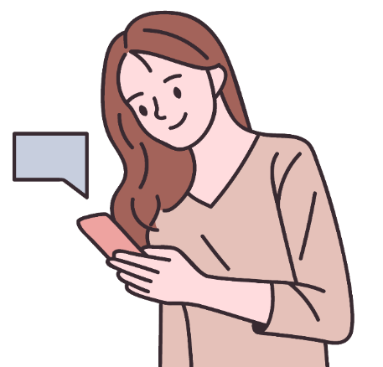
4 Let’s practise!
Beth and Ryan are chatting about exams.
Complete their conversation using your knowledge of Type 2 conditional sentences.
Back to Contents

Slide 13
ask be do feel give go
have learn spend start stay study
Beth: My life a breeze if I any exams!
Ryan: Yes, but if we for exams, we much slower.
Beth: Maybe, but I just wish I didn’t feel so stressed before an exam.
Ryan: If I you, I by finding a quiet place to study.
would be
didn’t have
didn’t study
would learn
were
would start
Back to Contents

Slide 14
ask be do feel give go
have learn spend start stay study
Beth: I to the library if it open till later.
Ryan: What about somewhere at home?
Beth: My brother plays his music too loudly.
Ryan: I’m sure that if you your parents to talk to him, they it.
Beth: I could try!
would go
stayed
asked
would do
Back to Contents

Slide 15
ask be do feel give go
have learn spend start stay study
Ryan: If I you, I myself more time to study for an exam too. If you more time studying for an exam, you less stressed before it.
Beth: I guess you’re right …
were
would give
spent
would feel
Back to Contents

Slide 16
6 How is the grammar used?
To talk about imaginary actions or situations, we can use …
would + the bare infinitive in the main clause to talk about the result
Beth: My life would be a breeze if I didn’t have any exams!
Ryan: Yes, but if we didn’t study for exams, we would learn much slower.
Beth: Maybe, but I just wish I didn’t feel so stressed before an exam.
Ryan: If I were you, I would start by finding a quiet place to study.
the simple past in the if-clause to talk about the imaginary action
If I were … to give advice
Back to Contents

Slide 17
6 How is the grammar used?
To talk about imaginary actions or situations, we can use …
would + the bare infinitive in the main clause to talk about the result
Beth: I would go to the library if it stayed open till later.
Ryan: What about somewhere at home?
Beth: My brother plays his music too loudly.
Ryan: I’m sure that if you asked your parents to talk to him, they would do it.
Beth: I could try!
the simple past in the if-clause to talk about the imaginary action
Back to Contents

Slide 18
6 How is the grammar used?
To talk about imaginary actions or situations, we can use …
If I were … to give advice
Ryan: If I were you, I would give myself more time to study for an exam too. If you spent more time studying for an exam, you would feel less stressed before it.
Beth: I guess you’re right …
the simple past in the if-clause to talk about the imaginary action
would + the bare infinitive in the main clause to talk about the result
Back to Contents

Slide 20
Acknowledgments
We are grateful to the following for permission to reproduce copyright photographs:
miniwide. Shutterstock
TijanaM. Shutterstock
Every effort has been made to trace copyright, but in the event of any accidental infringement, we shall be pleased to come to a suitable arrangement with the rightful owner.

