Slide 1
Unit 1
Comprehension 2
Dear Alex …
Dear Unhappy Teen …

Slide 2
Part A
Part B
Part C
CONTENTS

Slide 3
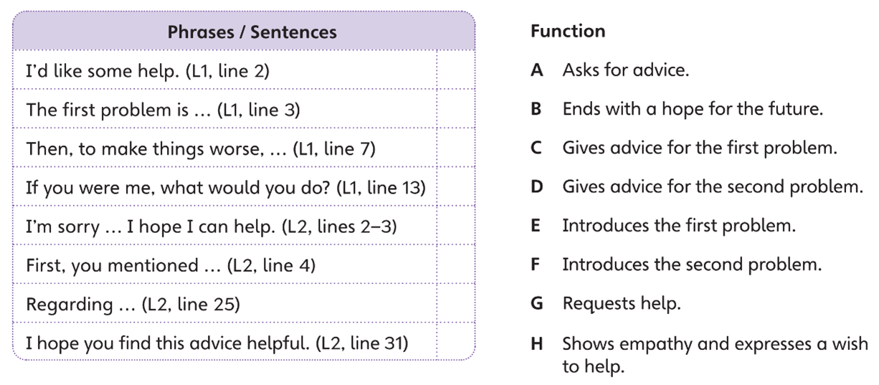
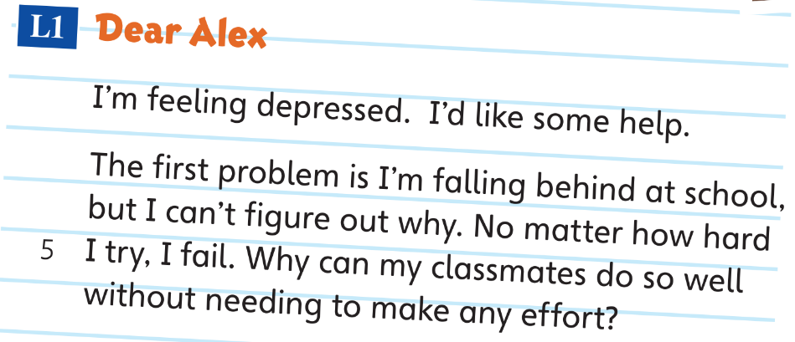
Part A
Part A
Part B
Part C

Slide 4
Part A
Part A
Part B
Part C

Slide 5
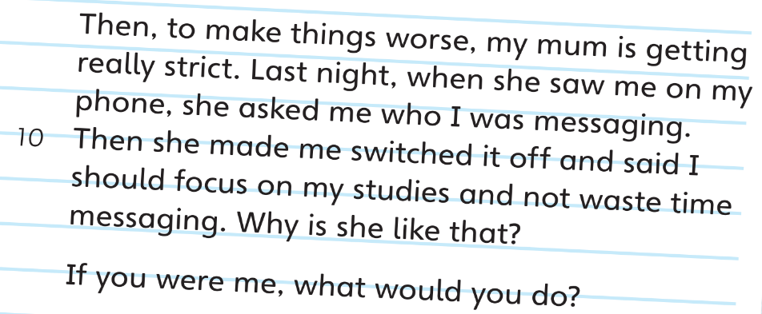
Part A
Part A
Part B
Part C

Slide 6
Part A
Part A
Part B
Part C

Slide 7
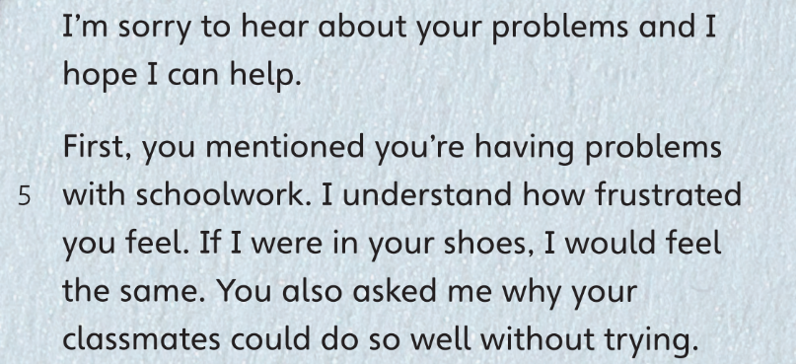
Part A
Part A
Part B
Part C

Slide 8
Part A
Part A
Part B
Part C

Slide 9
Part A
Part A
Part B
Part C

Slide 10
Part A
Part A
Part B
Part C

Slide 11
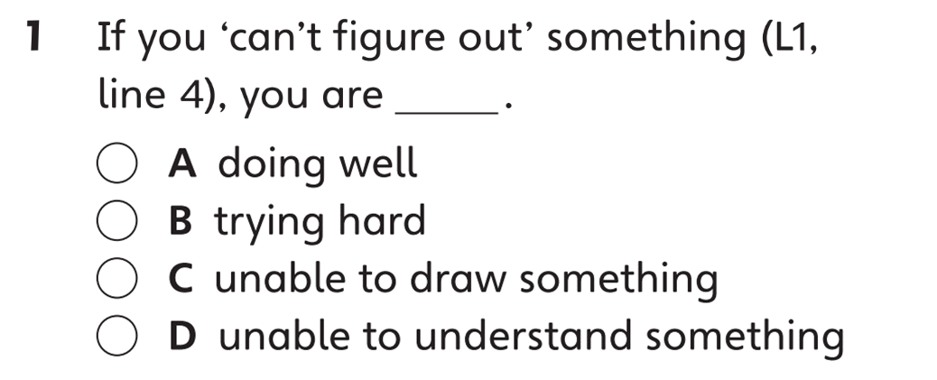
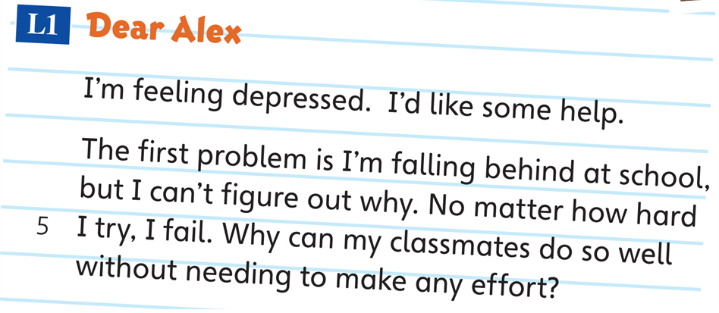
Part B
Part A
Part B
Part C

Slide 12
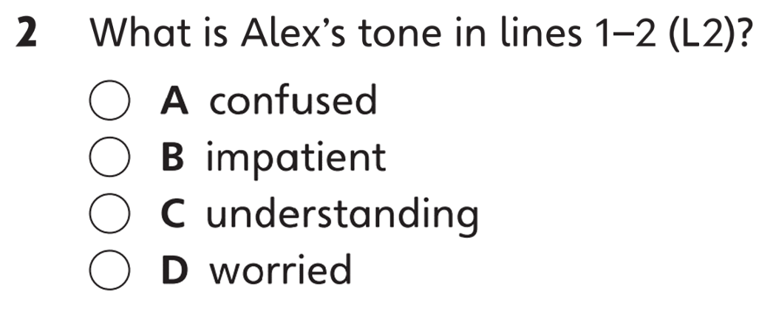
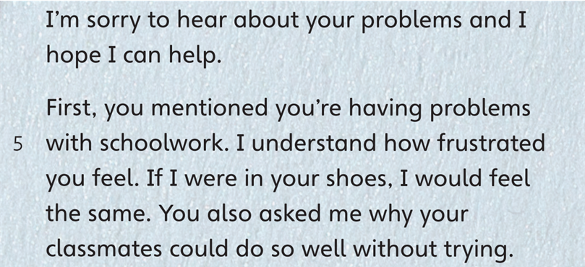
Part B
Part A
Part B
Part C

Slide 13
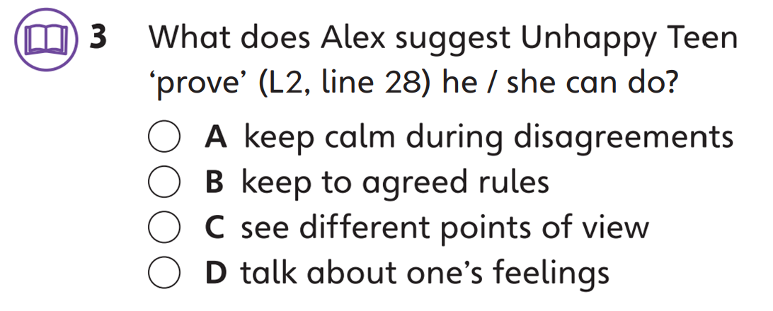
Part B
Part A
Part B
Part C

Slide 14
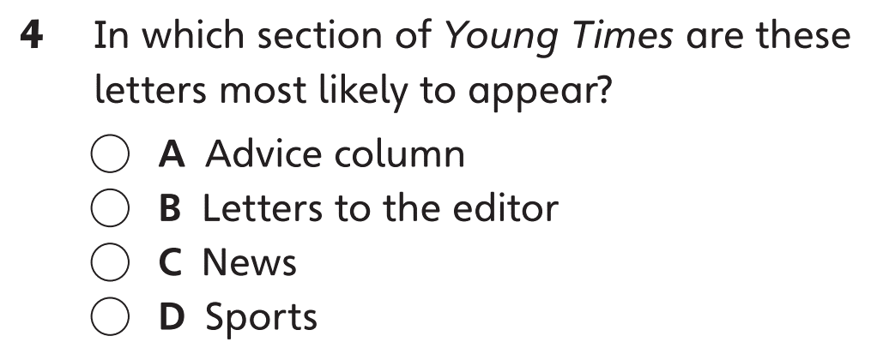
Part B
Part A
Part B
Part C

Slide 15
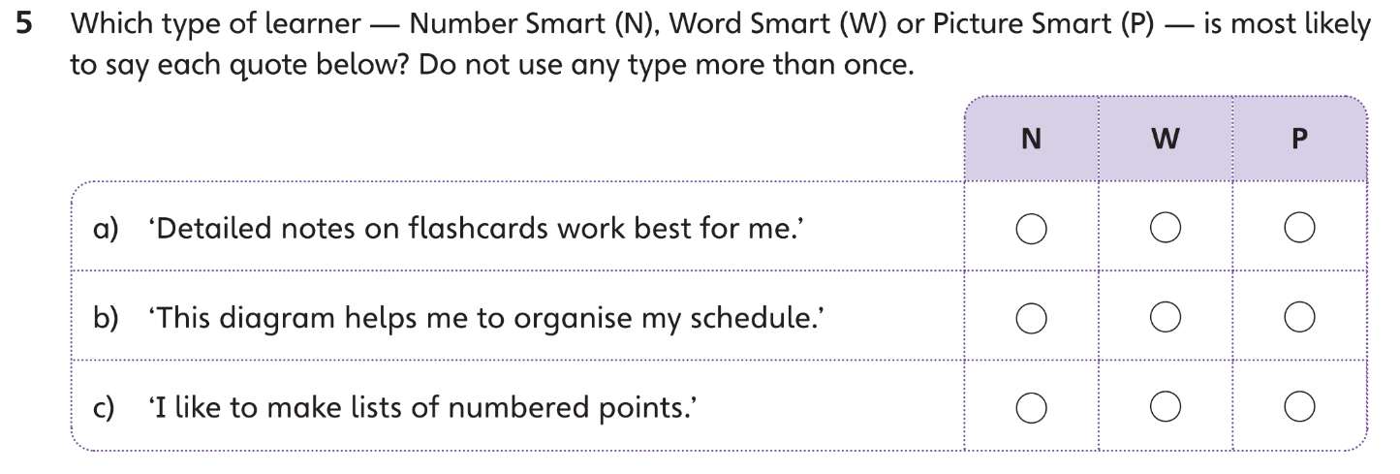
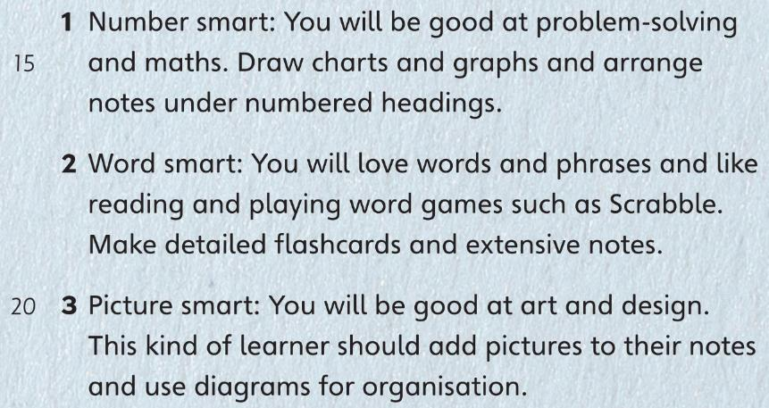
Part B
Part A
Part B
Part C

Slide 16
Part B
Part A
Part B
Part C

Slide 17
Part B
Part A
Part B
Part C

Slide 18
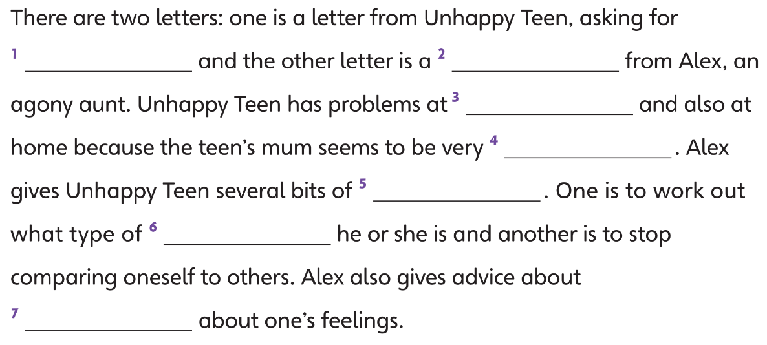
Part C
Part A
Part B
Part C

Slide 19
Part C
Part A
Part B
Part C

Slide 20
Part C
Part A
Part B
Part C

Slide 21
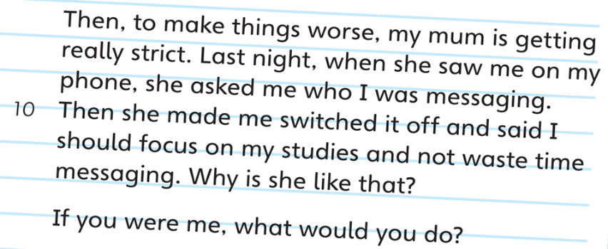
Part C
Part A
Part B
Part C

Slide 22
Part C
Part A
Part B
Part C

Slide 23
Part C
Part A
Part B
Part C

Slide 24
Part C
Part A
Part B
Part C

Slide 26
Acknowledgments
We are grateful to the following for permission to reproduce copyright photographs:
MishaMisha. Shutterstock
PannaKotta. Shutterstock
Every effort has been made to trace copyright, but in the event of any accidental infringement, we shall be pleased to come to a suitable arrangement with the rightful owner.

