Slide 1
Unit 1
Comprehension 1
Dealing with stress
Give yourself a hug

Slide 2

Part A
Part B
Part C
CONTENTS

Slide 3
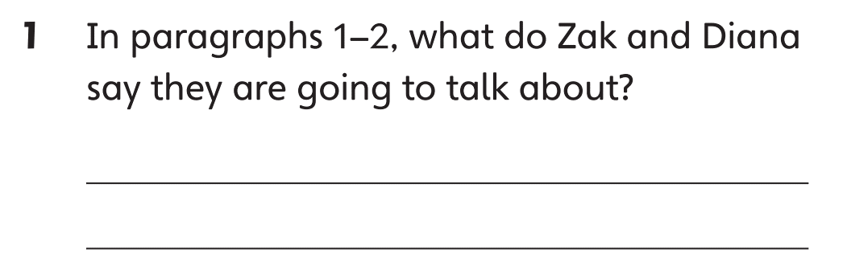

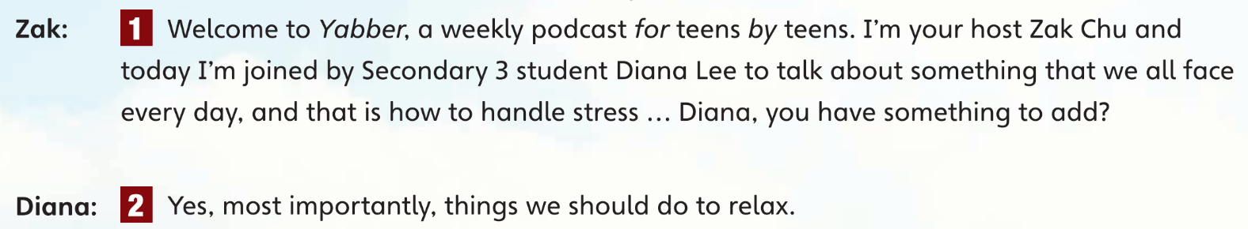
Part A
Part A
Part B
Part C

Slide 4
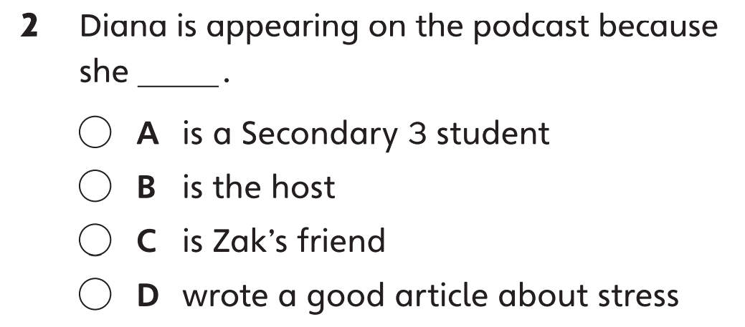

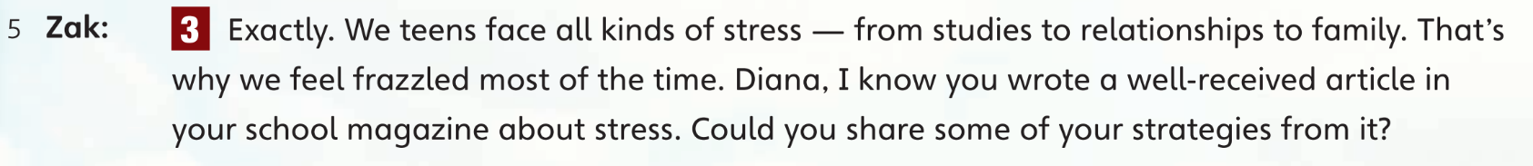
Part A
Part A
Part B
Part C

Slide 5


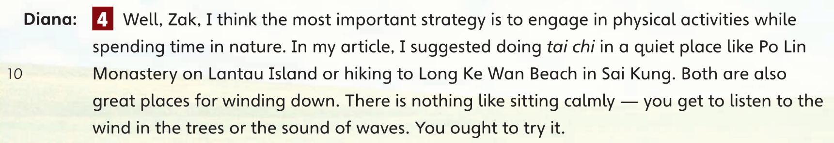
Part A
Part A
Part B
Part C

Slide 6
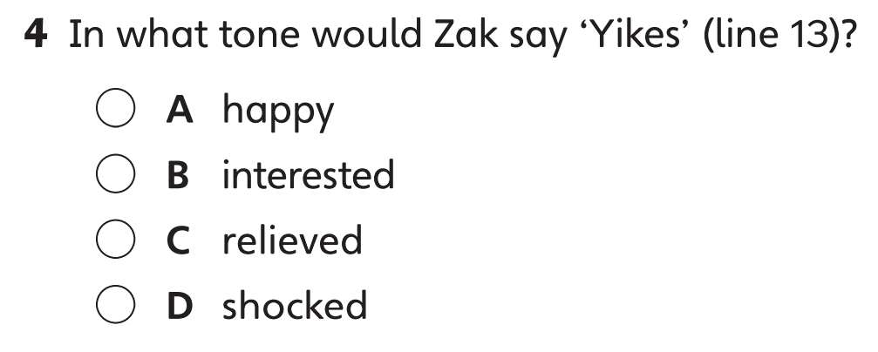
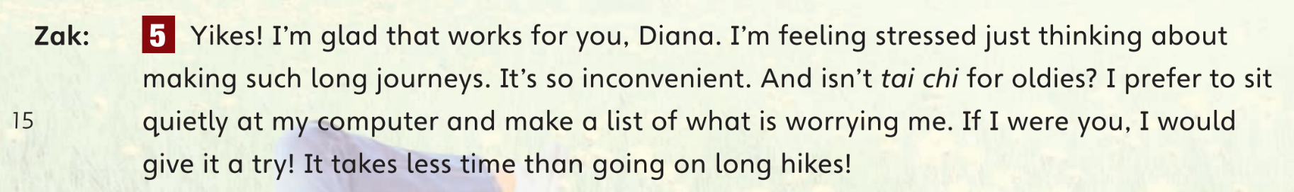
Part A
Part A
Part B
Part C

Slide 7
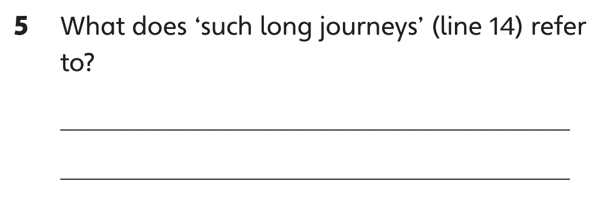

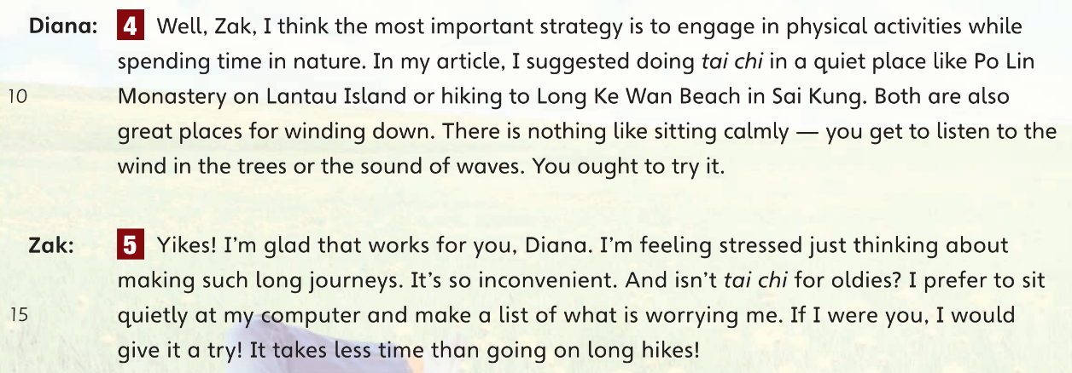
Part A
Part A
Part B
Part C

Slide 8
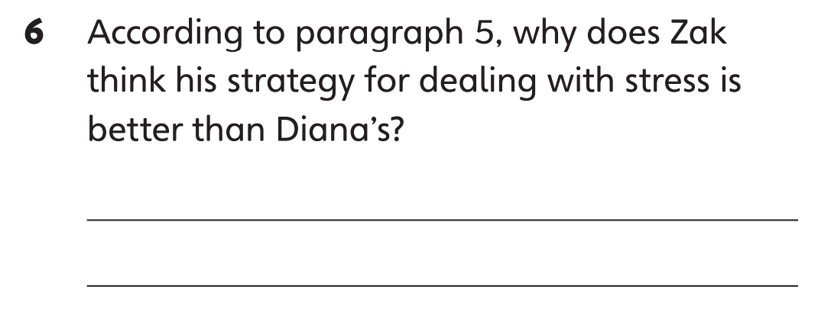
Part A
Part A
Part B
Part C

Slide 9
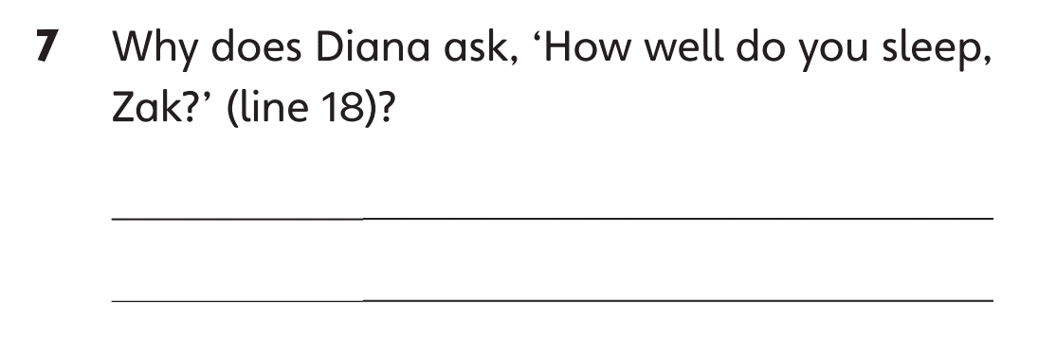
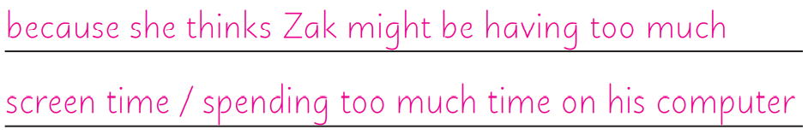
Part A
Part A
Part B
Part C

Slide 10
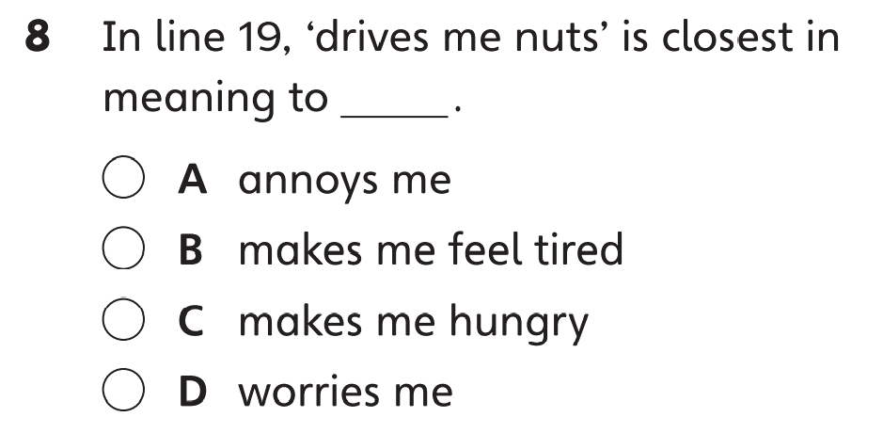

Part A
Part A
Part B
Part C

Slide 11


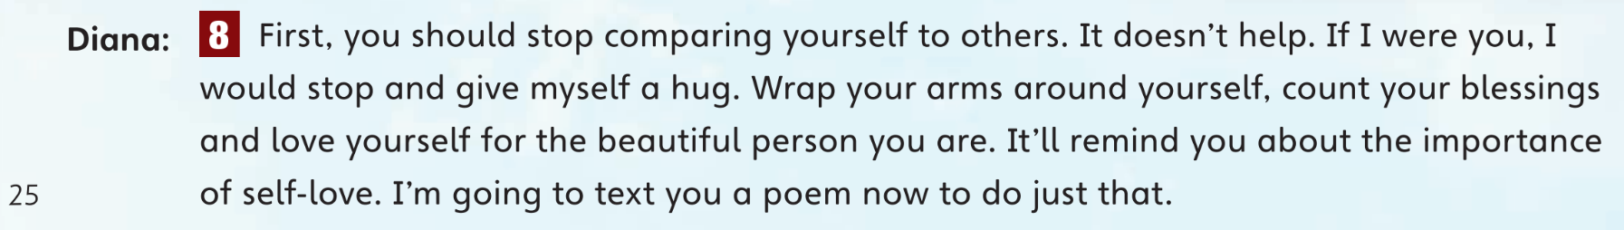
Part A
Part A
Part B
Part C

Slide 12
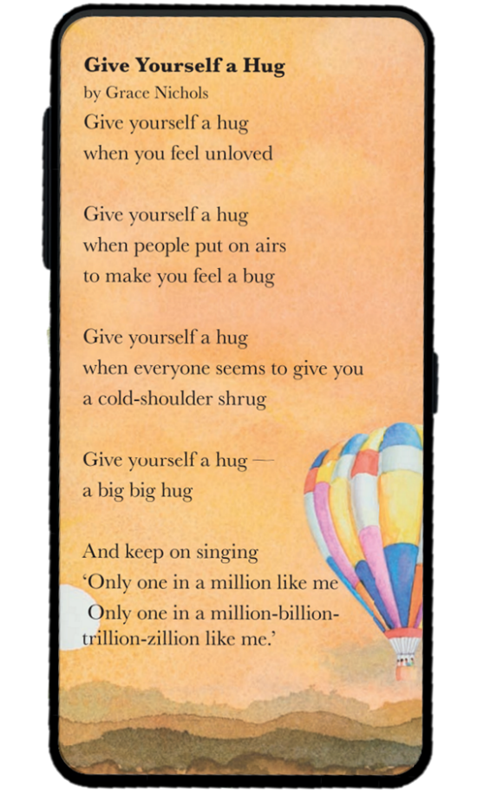
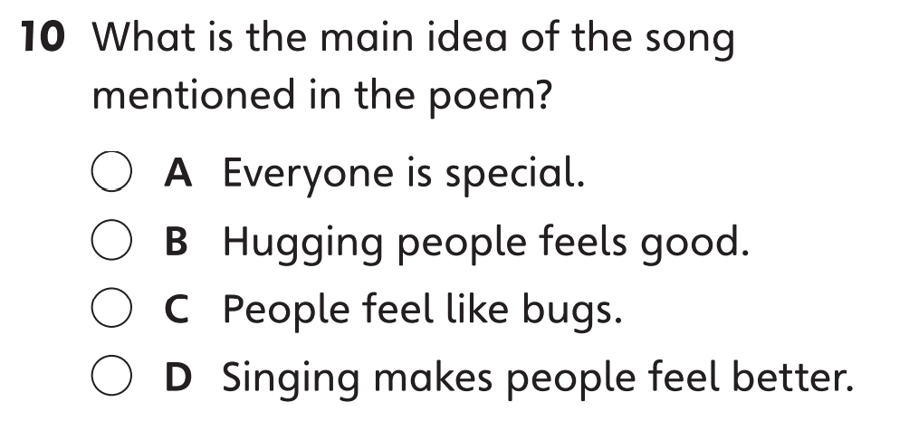
Part A
Part A
Part B
Part C

Slide 13
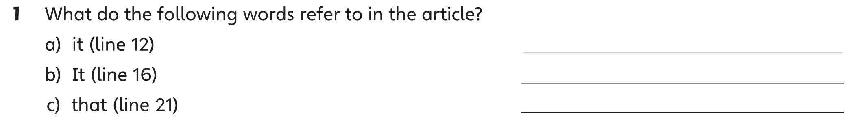
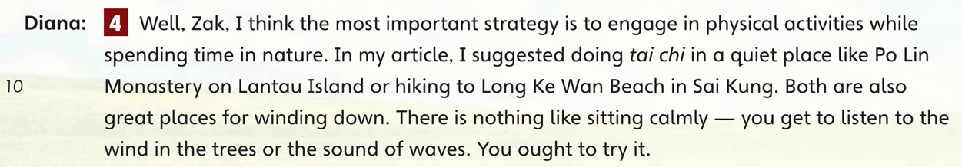
Part B
Part A
Part B
Part C

Slide 14

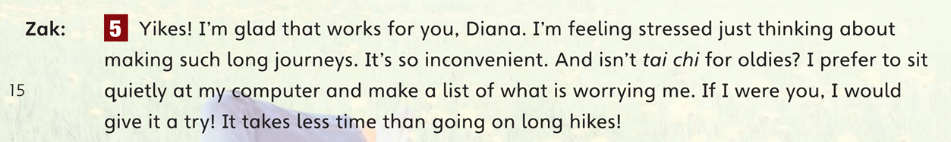
Part B
Part A
Part B
Part C

Slide 15

Part B
Part A
Part B
Part C

Slide 16
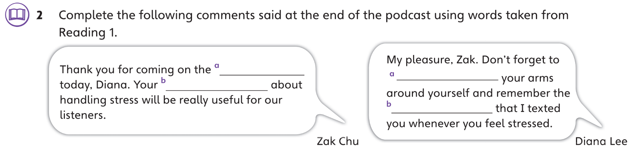

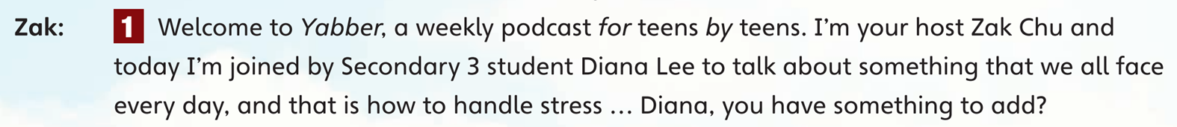
Part B
Part A
Part B
Part C

Slide 17

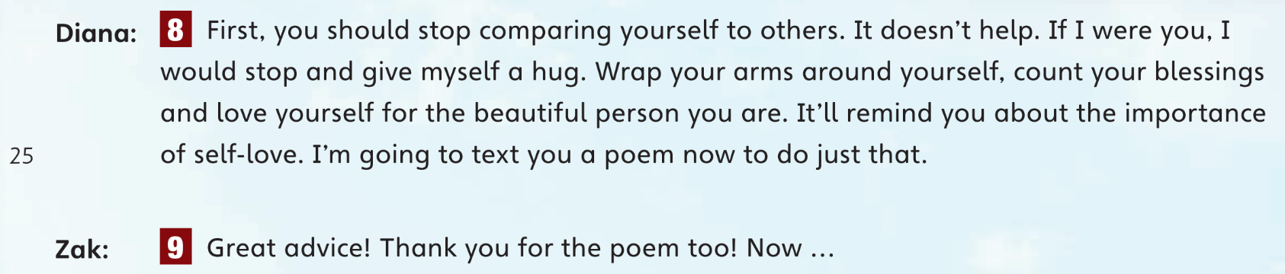
Part B
Part A
Part B
Part C

Slide 18

Part B
Part A
Part B
Part C

Slide 19

Part B
Part A
Part B
Part C

Slide 20
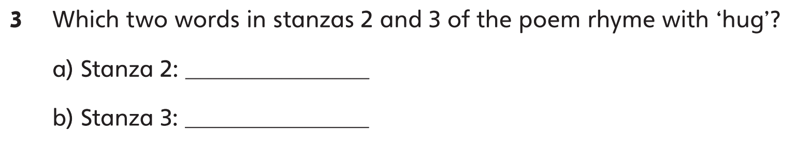

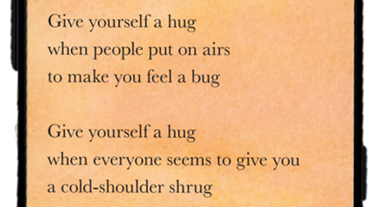
Part B
Part A
Part B
Part C

Slide 21

Part B
Part A
Part B
Part C

Slide 22
Part B
Part A
Part B
Part C

Slide 23
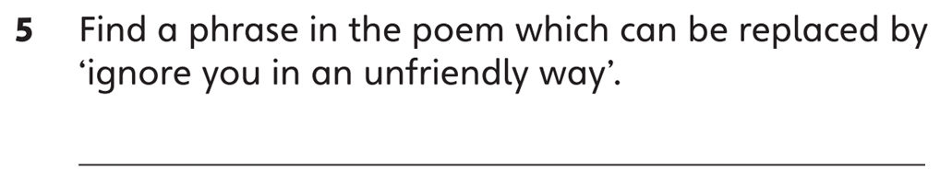
Part B
Part A
Part B
Part C

Slide 24
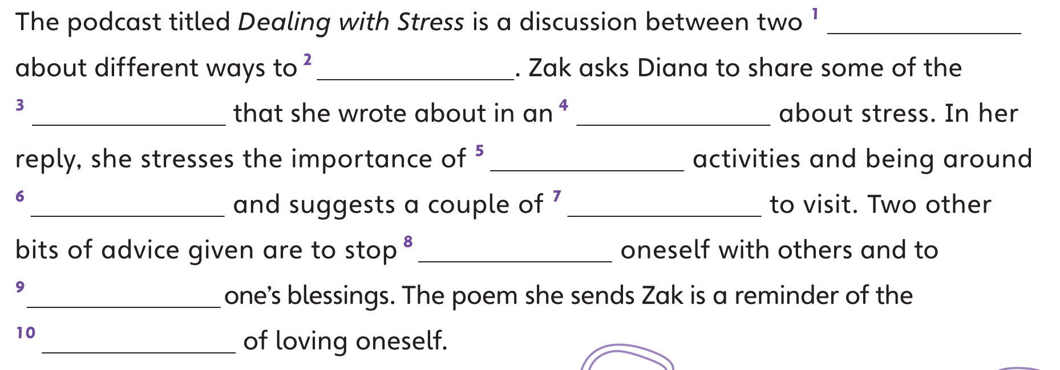

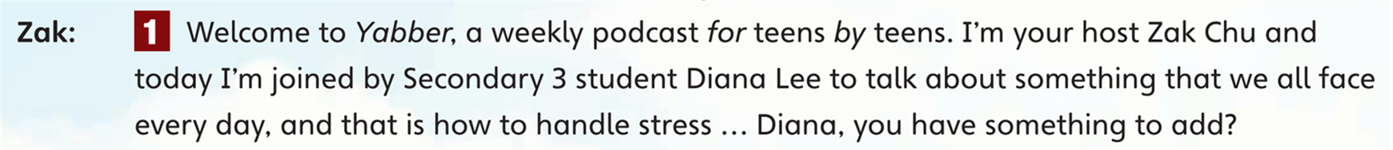
Part C
Part A
Part B
Part C

Slide 25

Part C
Part A
Part B
Part C

Slide 26

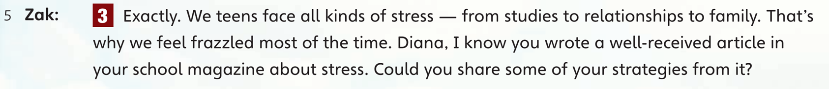
Part C
Part A
Part B
Part C

Slide 27

Part C
Part A
Part B
Part C

Slide 28

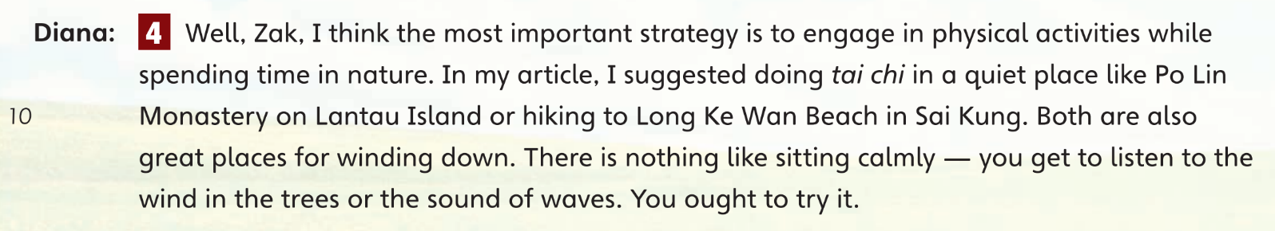
Part C
Part A
Part B
Part C

Slide 29

Part C
Part A
Part B
Part C

Slide 30

Part C
Part A
Part B
Part C

Slide 31

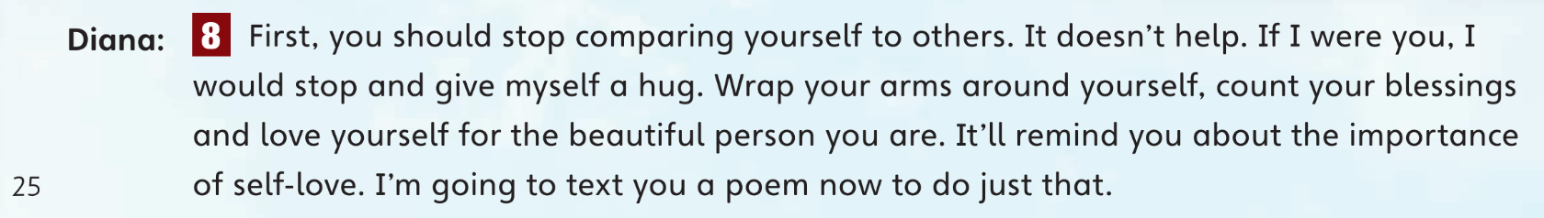
Part C
Part A
Part B
Part C

Slide 32

Part C
Part A
Part B
Part C

Slide 33

Part C
Part A
Part B
Part C

Slide 35
Acknowledgments
We are grateful to the following for permission to reproduce copyright text:
‘Give Yourself a Hug’ from Give Yourself a Hug
Copyright © Grace Nichols 1994
Reproduced with permissions from Curtis Brown Group Ltd on behalf of Grace Nichols.
We are grateful to the following for permission to reproduce copyright photographs:
LeManna. Shutterstock
Painterstock. Shutterstock
SpicyTruffel. Shutterstock
Every effort has been made to trace copyright, but in the event of any accidental infringement, we shall be pleased to come to a suitable arrangement with the rightful owner.

