Slide 1
Unit 2
Task
Write an article about a hobby

Slide 3
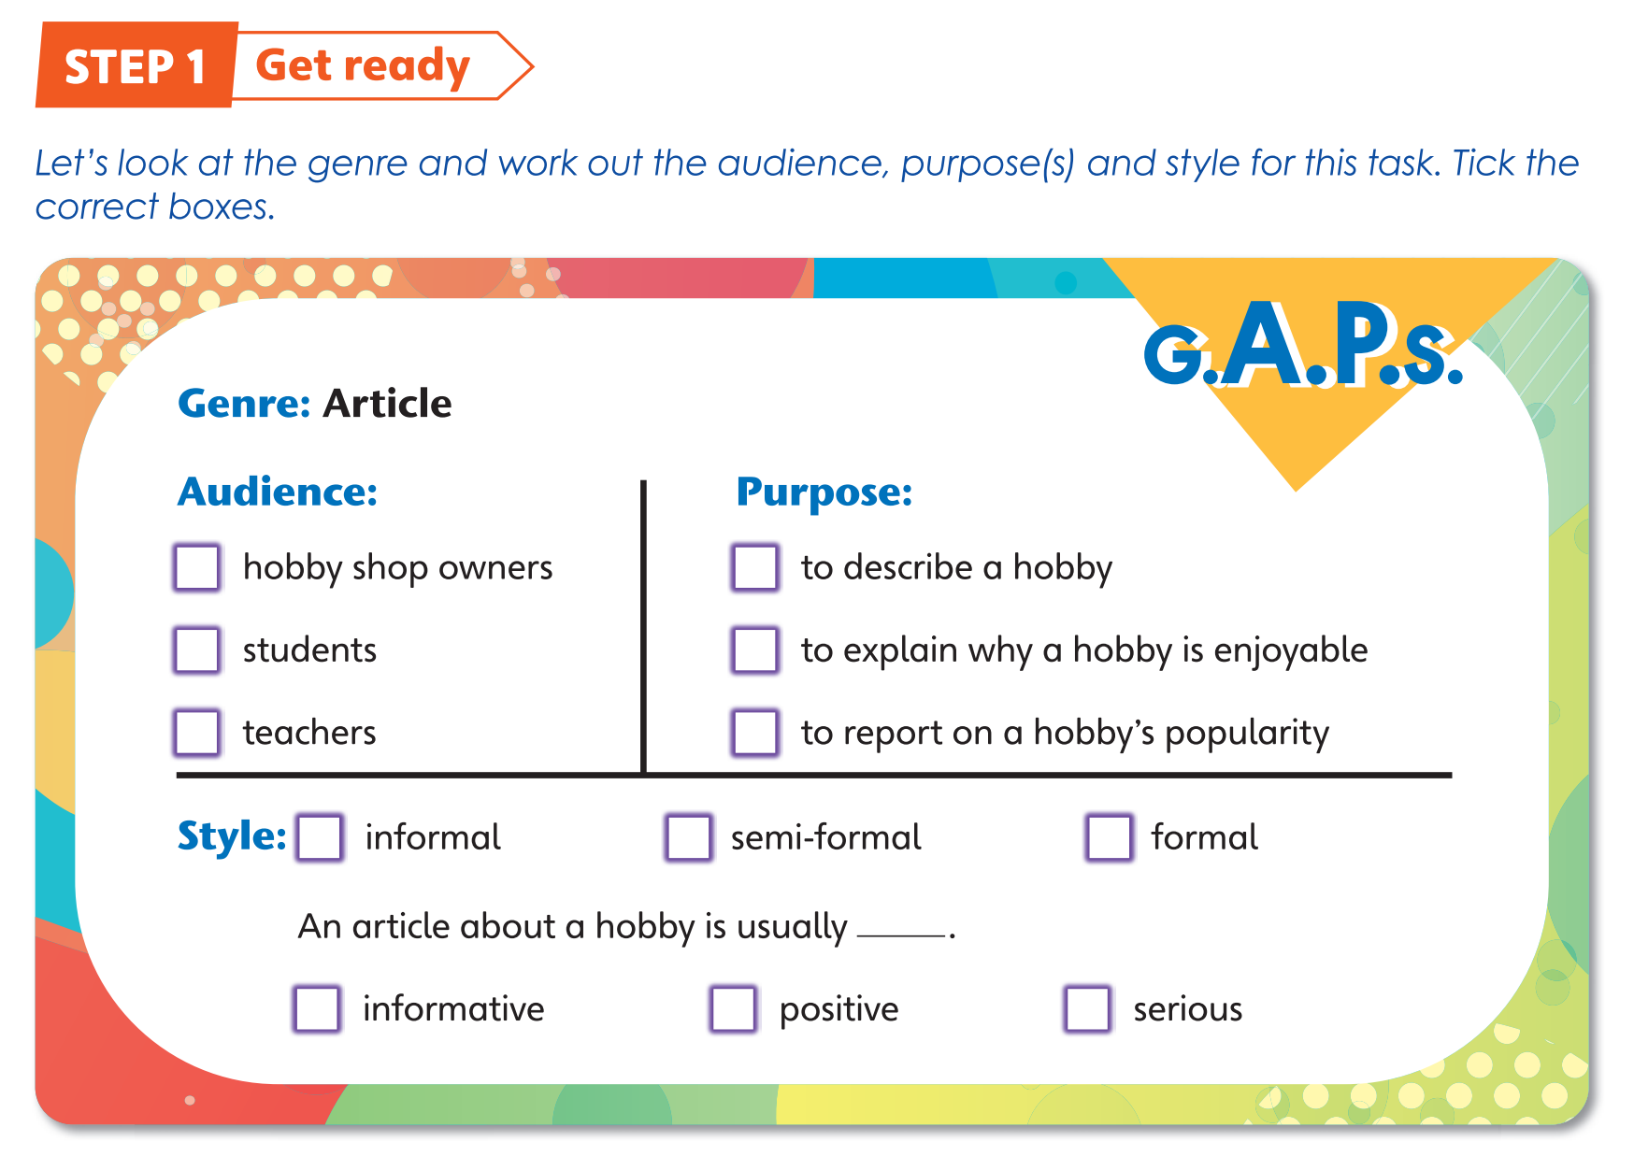

Slide 4
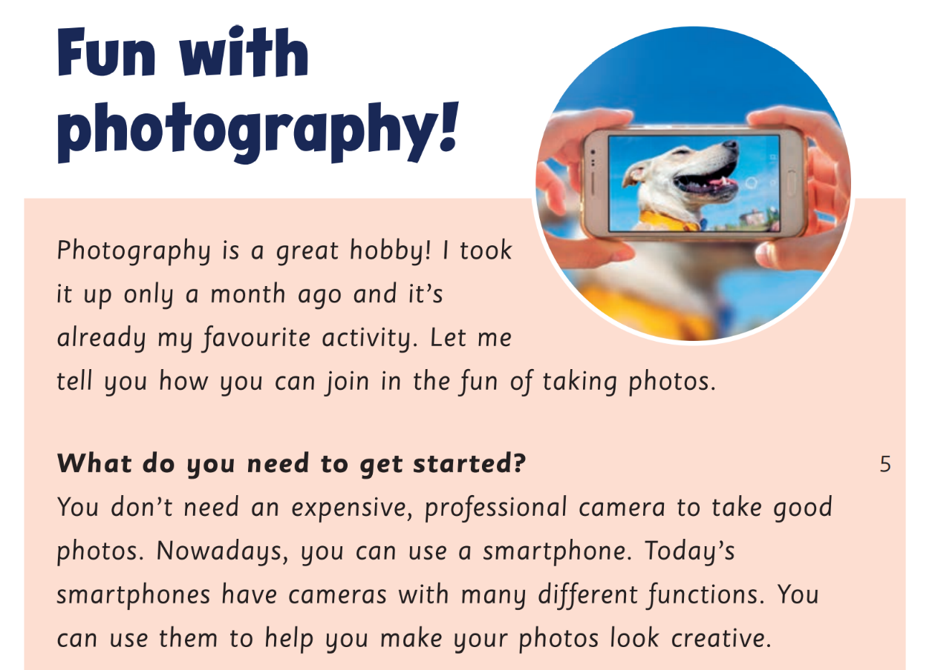
Read the article below.

Slide 5
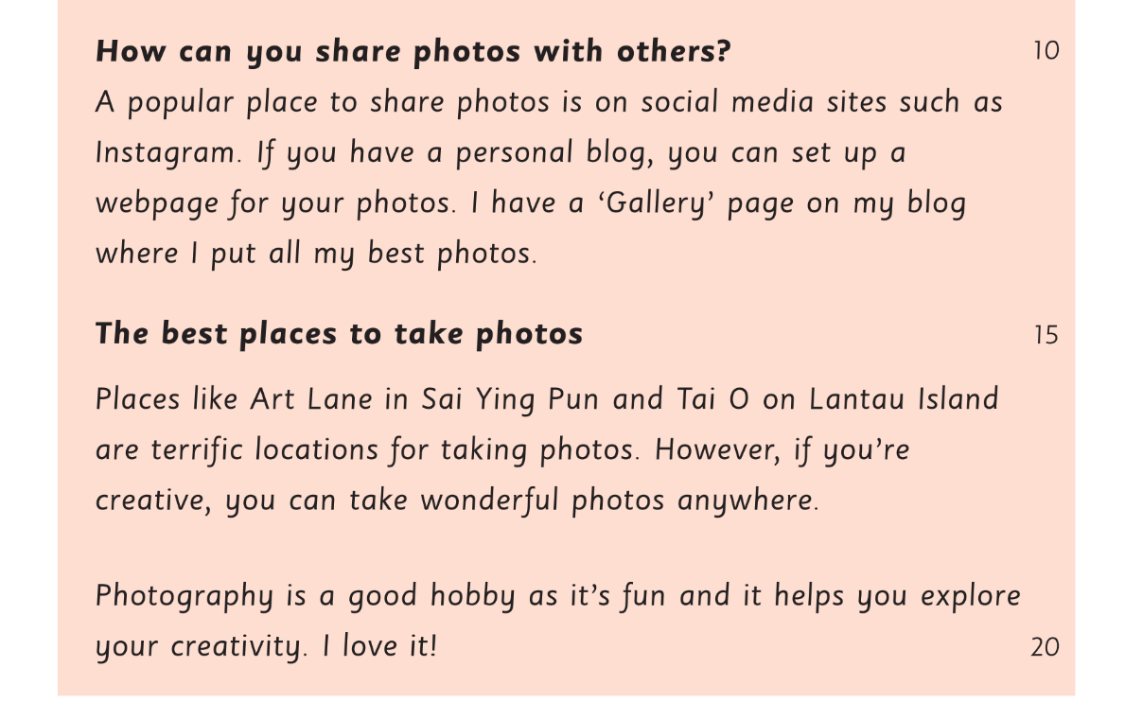

Slide 6
Label the article with the correct guidelines.
A Give a closing comment, e.g. reason(s) why photography is a good hobby.
B Give some relevant details for each aspect of the hobby.
C Introduce the article, e.g. by saying something about the topic of the article and what readers can expect to find out about it.
D Use a short, eye-catching title.
E Use a subheading for each aspect of the hobby.

Slide 7
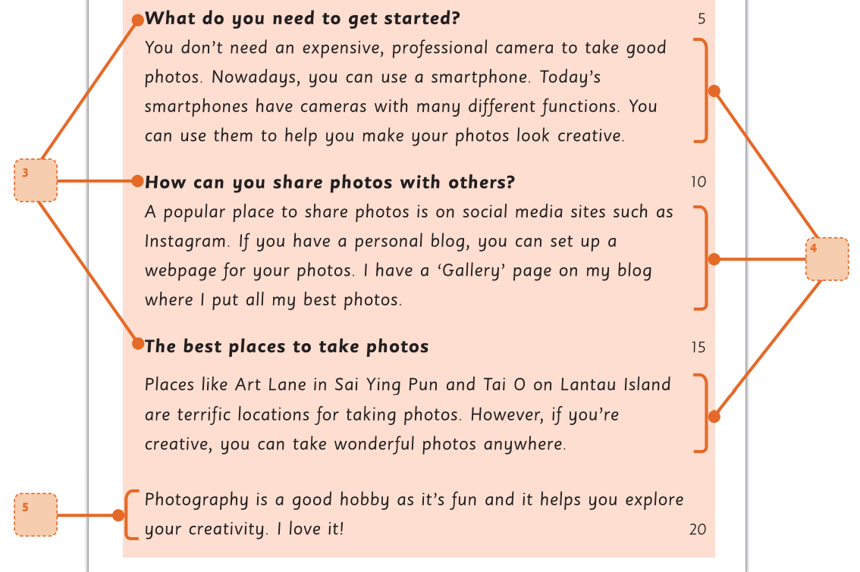
A Give a closing comment, e.g. reason(s) why photography is a good hobby.
B Give some relevant details for each aspect of the hobby.
C Introduce the article, e.g. by saying something about the topic of the article and what readers can expect to find out about it.
D Use a short, eye-catching title.
E Use a subheading for each aspect of the hobby.

Slide 8
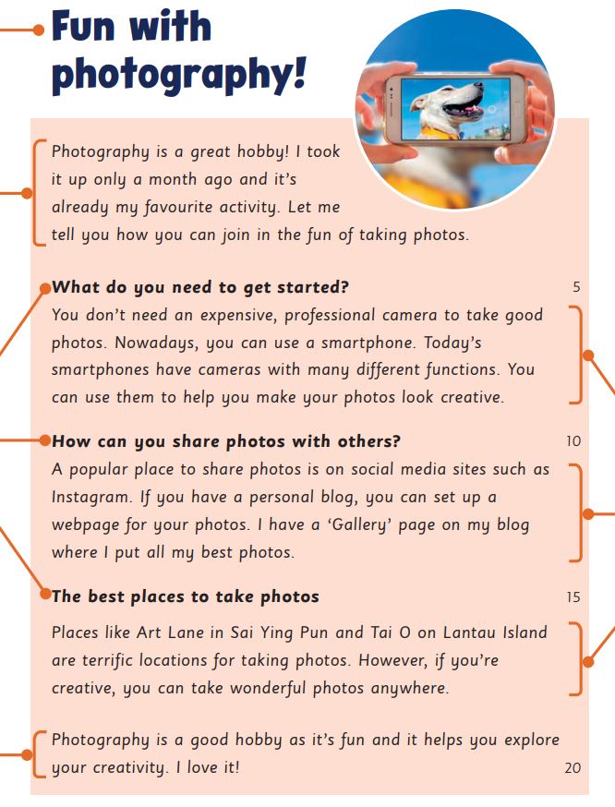
D Use a short, eye-catching title.
C Introduce the article, e.g. by saying something about the topic of the article and what readers can expect to find out about it.
E Use a subheading for each aspect of the hobby.
B Give some relevant details for each aspect of the hobby.
A Give a closing comment, e.g. reason(s) why photography is a good hobby.

Slide 9
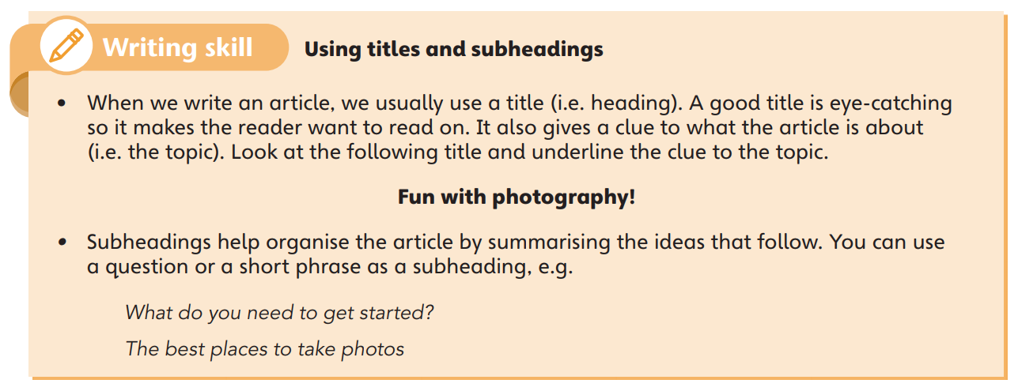

Slide 10
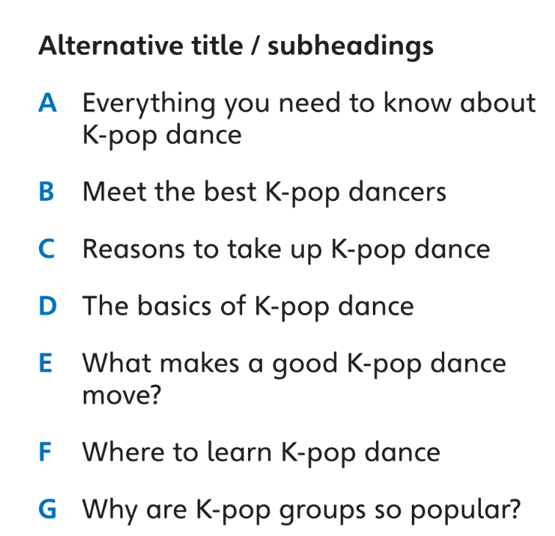
Look back at the article in Reading 2 on pages 34–35. Choose an appropriate alternative title and subheadings for the article from A–G. Two letters are not used.
A

Slide 11
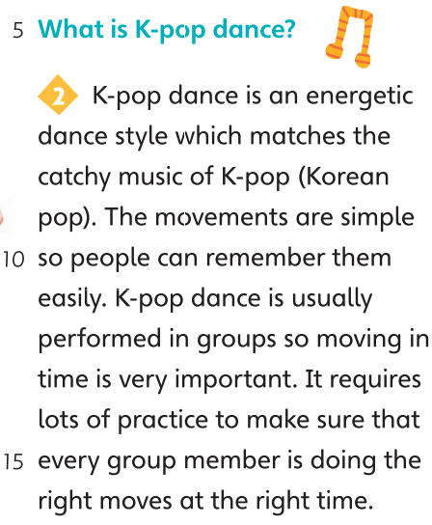
A
D

Slide 12
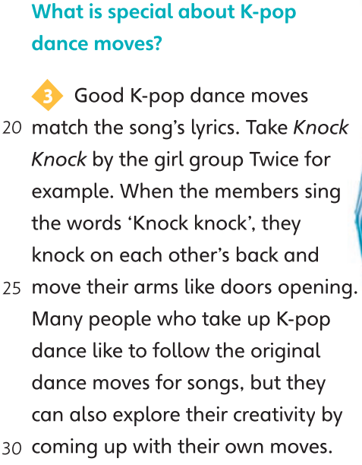
A
D
E

Slide 13
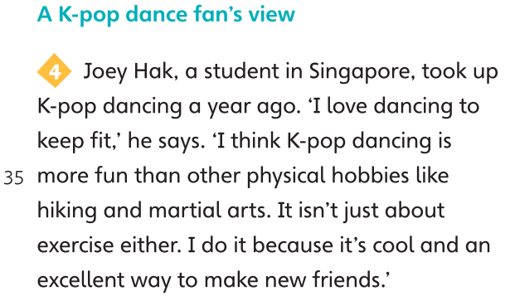
A
D
E
C

Slide 14
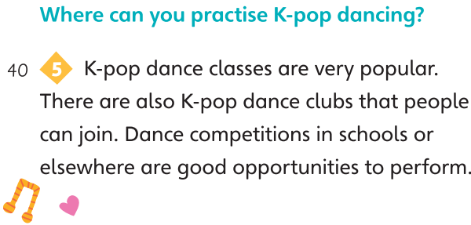
A
D
E
C
F

Slide 15
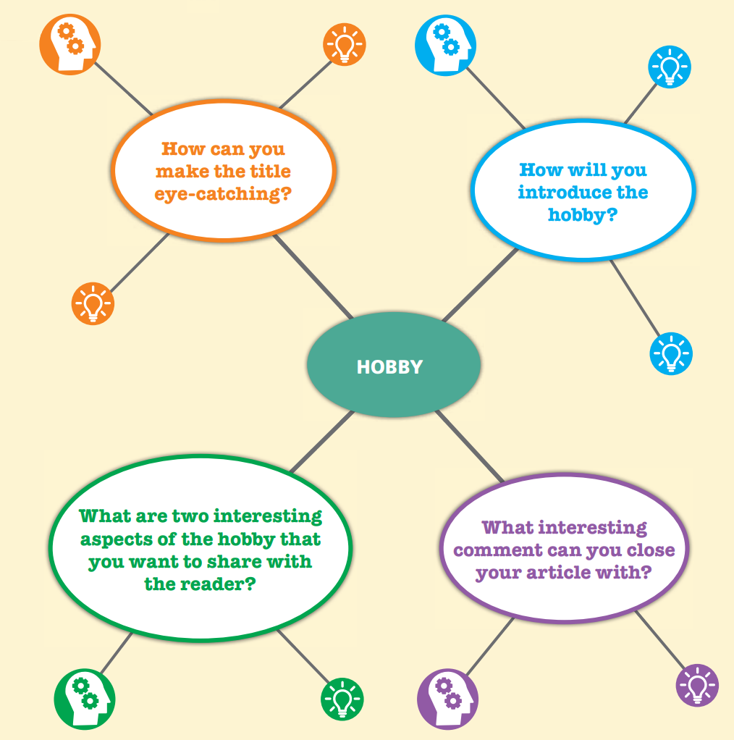
Here are some useful ideas to help you with your writing.

Slide 16
Here are some useful words and phrases.
Describing hobbies
… is a good hobby for people who …
People wo have good … skills might like to try …
I’m … so I often choose hobbies that I can do with others / with my friends / on my own.
After school, I like to … so all my hobbies involve …
Describing the qualities needed for different hobbies
A good … needs to be … / have …
When you …, you need to concentrate / pay attention to detail.
You need to be / have … to do / play the … well.

Slide 17
Describing how a hobby makes you feel
I feel … when I …
I’m transported to another world when I …
I forget about all my worries when I …
I feel appreciated when I …
Giving a closing comment
Hobbies help us explore …
Hobbies can help us become / have …
We should all try …

Slide 18
Sample writing
Exploring Hong Kong one step at a time
Most visitors to Hong Kong expect bright lights and tall buildings. They don’t expect to find some of the best hiking trails in the world. I felt the same way until I joined the school Hiking Club. Now, I go hiking with the club every weekend and I love it.
Best trail in Hong Kong
Hong Kong has 610 kilometres of hiking trails. The most amazing trail is the newly-opened 65-kilometre long Coastal Trail. Follow this route and you can walk all the way around Hong Kong Island.
When is the best time to go hiking?
Autumn is the best time to hike in Hong Kong because the weather is mainly cool and dry.
Why do I love hiking?
I love it because I can have fun with friends. I’ve also developed new skills like map reading and first-aid skills.
We live in a beautiful part of the world and hiking is a great way to explore it.

Slide 20
Acknowledgments
We are grateful to the following for permission to reproduce copyright photographs:
4 PM production. Shutterstock
Alex Photo Stock. Shutterstock
APIWAN BORRIKONRATCHATA. Shutterstock
Choo Studio. Shutterstock
colnihko. Shutterstock
Jacek Chabraszewski. 123rf.com
Jade ThaiCatwalk. Shutterstock
Phonix_a Pk.sarote. Shutterstock
Photoongraphy. Shutterstock
SeventyFour. Shutterstock
Vektor illustration. Shutterstock
Every effort has been made to trace copyright, but in the event of any accidental infringement, we shall be pleased to come to a suitable arrangement with the rightful owner.

