Slide 1
Unit 2
Short vowels

Slide 2
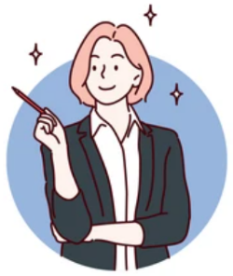
Short vowels
Most English words contain one or more vowel sounds. Some vowel sounds (e.g. hit) are short and some are long (e.g. heat).
Let’s look at the following short vowels.

Slide 3
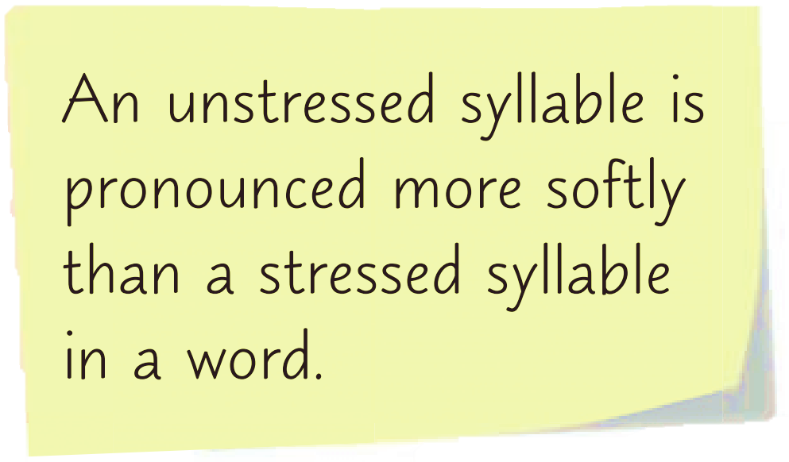

Slide 5
The most common short vowel is the schwa sound /ǝ/. It is used in unstressed syllables.
about collect exercise number

Slide 6
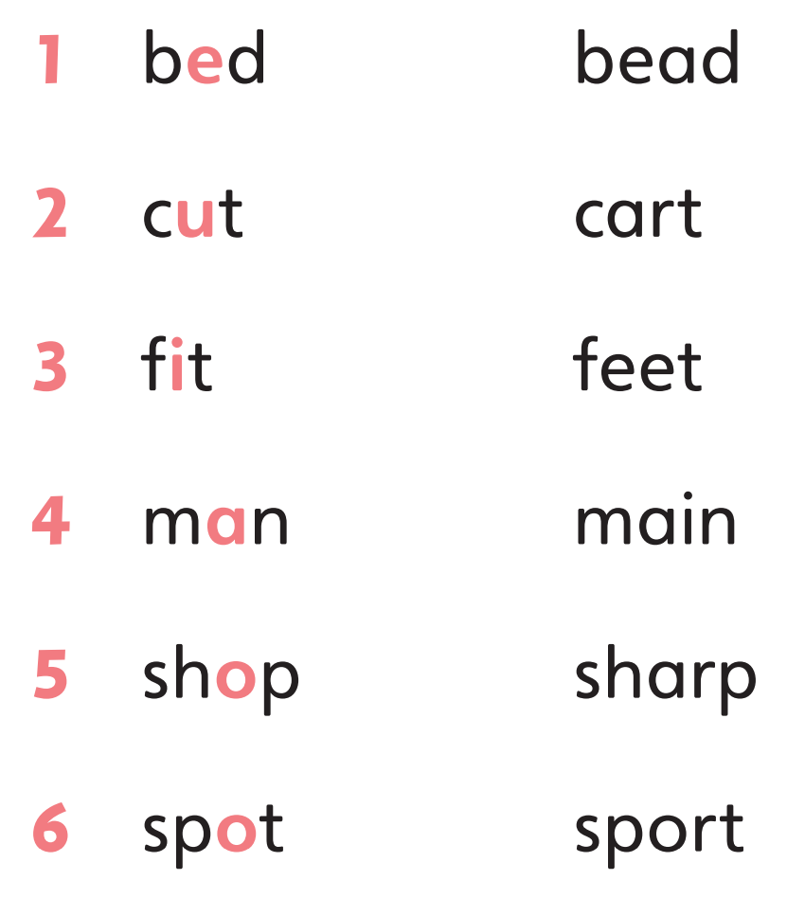
The first word in the following pairs of words has a short vowel. Listen to the pairs of words and repeat them.

Slide 7
Listen to the following conversation. Pay attention to the underlined parts. Which short vowels are used?
/ɪ/
Riya: What’s in your bag?
Joey: It’s my collection of comic books.
Riya: Can you let me take a look, please?
Joey: Sure! Please be careful with them.
Riya: Don’t worry! I’ll take extra care with them.
Joey: I think you’ll like them very much.
/ɒ/
/æ/
/ɪ/
/e/
/ɒ/
/ɪ/
/ʊ/
/e/
/ʊ/
/ɪ/
/ʌ/
/i/
/e/
/ɪ/
/ɪ/
/e/
/i/
/ʌ/

Slide 8
Now work in pairs and read aloud the conversation.

Slide 10
Acknowledgments
We are grateful to the following for permission to reproduce copyright photographs:
autumnn. Shutterstock
impresja26. Shutterstock
Every effort has been made to trace copyright, but in the event of any accidental infringement, we shall be pleased to come to a suitable arrangement with the rightful owner.

