Slide 1
Unit 2
Working out the meaning of words and phrases (I)

Slide 2
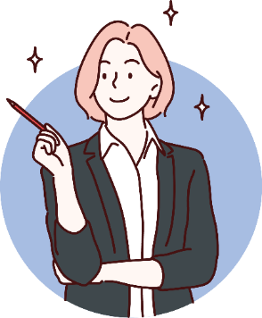
When we read a new text, we may come across some words that we do not understand.

Slide 3
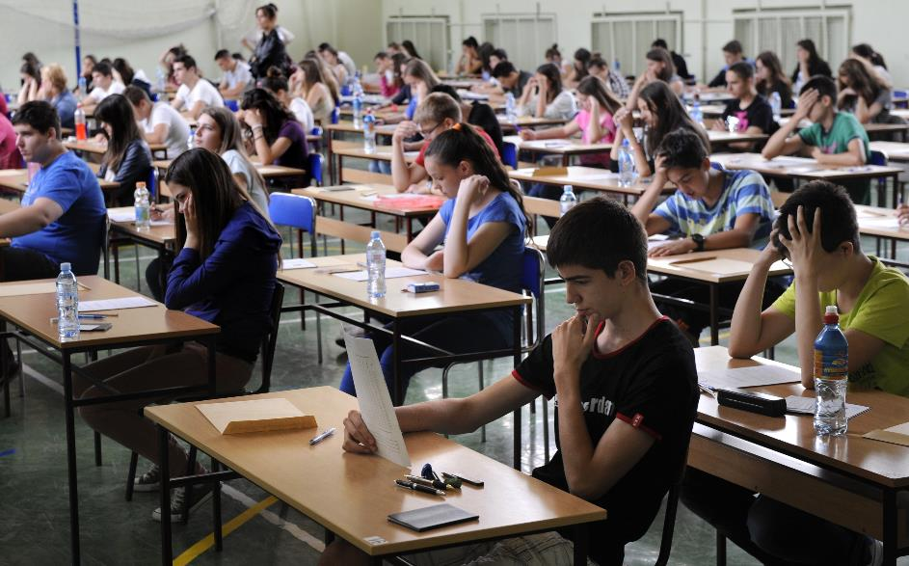
We won’t always need to check them in a dictionary … or we can’t!

Slide 4
However, we can be like a detective and look for clues in the text to help us work out the meaning!

Slide 5
Working out the meaning of words and phrases (I)
When we read, we sometimes see words and phrases that we do not know. However, we can guess their meaning by looking for clues in the surrounding text to help us work out the meaning.

Slide 6
Frankie is a gifted photographer. He took up photography a year ago. Last month, he won first prize at a photography competition.
What is the meaning of ‘gifted’?
A beginner
B talented

Slide 7
Frankie is a gifted photographer. He took up photography a year ago. Last month, he won first prize at a photography competition.
What is the meaning of ‘gifted’?
Look for clues in the surrounding text to help us work out the meaning.

Slide 8
Frankie is a gifted photographer. He took up photography a year ago. Last month, he won first prize at a photography competition.
What is the meaning of ‘gifted’?
Highlight the clues that help us answer the question.

Slide 9
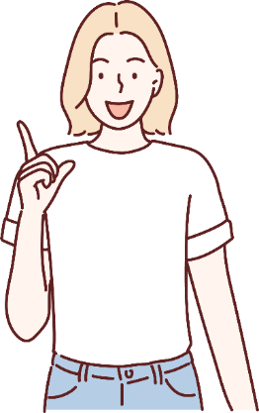
Frankie is a gifted photographer. He took up photography a year ago. Last month, he won first prize at a photography competition.
Frankie ‘took up photography a year ago’, so this hobby is not brand-new to him – he is not a ‘beginner’ photographer.
However, he is not very experienced ...

Slide 10
Frankie is a gifted photographer. He took up photography a year ago. Last month, he won first prize at a photography competition.
… yet he ‘won first prize at a photography competition’ – Frankie has an admirable ability or skill to do something well.

Slide 11
Frankie is a gifted photographer. He took up photography a year ago. Last month, he won first prize at a photography competition.
What is the meaning of ‘gifted’?
A beginner
B talented
So the answer to this question is …

Slide 12
Frankie is a gifted photographer. He took up photography a year ago. Last month, he won first prize at a photography competition.
What is the meaning of ‘gifted’?
A beginner
B talented
Well done!

Slide 13
Let’s look at more examples!

Slide 14
It may look like a misshapen monster, but in fact it’s an ‘ugly’ apple on sale at one of France’s most popular supermarkets. Elsewhere, other shops are selling out-of-date goods and donating food to charity.
In the text, ‘misshapen’ is closest in meaning to …
A oddly shaped
B rather old
C tasteless
D too small

Slide 15
It may look like a misshapen monster, but in fact it’s an ‘ugly’ apple on sale at one of France’s most popular supermarkets. Elsewhere, other shops are selling out-of-date goods and donating food to charity.
It may look like a misshapen monster, but in fact it’s an ‘ugly’ apple on sale at one of France’s most popular supermarkets. Elsewhere, other shops are selling out-of-date goods and donating food to charity.
In the text, ‘misshapen’ is closest in meaning to …
Look for clues from the sentence that ‘misshapen’ is in.

Slide 16
It may look like a misshapen monster, but in fact it’s an ‘ugly’ apple on sale at one of France’s most popular supermarkets. Elsewhere, other shops are selling out-of-date goods and donating food to charity.
It may look like a misshapen monster, but in fact it’s an ‘ugly’ apple on sale at one of France’s most popular supermarkets. Elsewhere, other shops are selling out-of-date goods and donating food to charity.
In the text, ‘misshapen’ is closest in meaning to …
we know that ‘misshapen’ is about how the apple looks
‘ugly’ also tells us about its appearance
‘monster’ suggests what it looks like too

Slide 17
It may look like a misshapen monster, but in fact it’s an ‘ugly’ apple on sale at one of France’s most popular supermarkets. Elsewhere, other shops are selling out-of-date goods and donating food to charity.
It may look like a misshapen monster, but in fact it’s an ‘ugly’ apple on sale at one of France’s most popular supermarkets. Elsewhere, other shops are selling out-of-date goods and donating food to charity.
In the text, ‘misshapen’ is closest in meaning to …
Bonus clue!
Look at the word ‘misshapen’:
‘mis’
+ ‘shape’
+ ‘en’

Slide 18
It may look like a misshapen monster, but in fact it’s an ‘ugly’ apple on sale at one of France’s most popular supermarkets. Elsewhere, other shops are selling out-of-date goods and donating food to charity.
In the text, ‘misshapen’ is closest in meaning to …
A oddly shaped
B rather old
C tasteless
D too small
Choose the best answer.

Slide 19
It may look like a misshapen monster, but in fact it’s an ‘ugly’ apple on sale at one of France’s most popular supermarkets. Elsewhere, other shops are selling out-of-date goods and donating food to charity.
In the text, ‘misshapen’ is closest in meaning to …
A oddly shaped
B rather old
C tasteless
D too small
Well done!

Slide 20
Here’s one more example.

Slide 21
You need to be fit to take part in a cycling race. As you jostle for space in the pack, you may get close to other cyclists. One wrong move, and you could lose your balance and fall off.
Which of the following words is closest in meaning to ‘jostle’?
A ask
B fall
C push
D wait

Slide 22
You need to be fit to take part in a cycling race. As you jostle for space in the pack, you may get close to other cyclists. One wrong move, and you could lose your balance and fall off.
Which of the following words is closest in meaning to ‘jostle’?
A ask
B fall
Which answer best replaces ‘jostle’?
C push
D wait

Slide 23
You need to be fit to take part in a cycling race. As you jostle for space in the pack, you may get close to other cyclists. One wrong move, and you could lose your balance and fall off.
Which of the following words is closest in meaning to ‘jostle’?
A ask
B fall
Choose the one which fits the context best.
C push
D wait

Slide 24
You need to be fit to take part in a cycling race. As you jostle for space in the pack, you may get close to other cyclists. One wrong move, and you could lose your balance and fall off.
Which of the following words is closest in meaning to ‘jostle’?
A ask
B fall
If we use ‘push’ in the sentence, does it still make sense?
C push
D wait

Slide 25
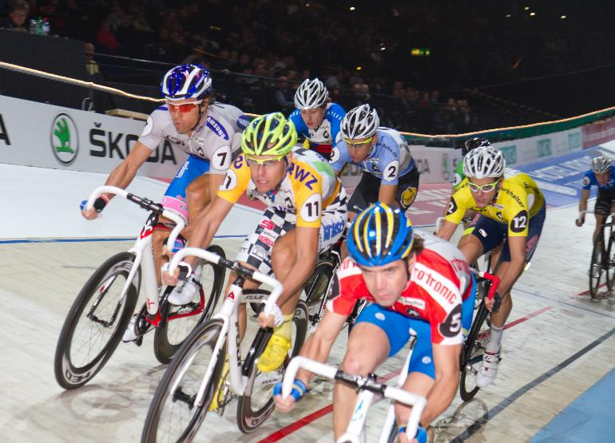
You need to be fit to take part in a cycling race. As you jostle for space in the pack, you may get close to other cyclists. One wrong move, and you could lose your balance and fall off.
‘As you push for space in the pack, you may get close to other cyclists.’

Slide 26
You need to be fit to take part in a cycling race. As you jostle for space in the pack, you may get close to other cyclists. One wrong move, and you could lose your balance and fall off.
Which of the following words is closest in meaning to ‘jostle’?
A ask
B fall
So the best answer to this question is …
C push
D wait

Slide 27
You need to be fit to take part in a cycling race. As you jostle for space in the pack, you may get close to other cyclists. One wrong move, and you could lose your balance and fall off.
Which of the following words is closest in meaning to ‘jostle’?
A ask
B fall
C push
D wait
Well done!

Slide 28
Let’s review this one last time …
Working out the meaning of words and phrases (I)
When we read, we sometimes see words and phrases that we do not know. However, we can guess their meaning by looking for clues in the surrounding text to help us work out the meaning.

Slide 30
Acknowledgments
We are grateful to the following for permission to reproduce copyright photographs:
bibiphoto. Shutterstock
Chuenmanuse. Shutterstock
Martin Lehmann. Shutterstock
Sabphoto. Shutterstock
sebra. Shutterstock
SofiaV / Shutterstock
Every effort has been made to trace copyright, but in the event of any accidental infringement, we shall be pleased to come to a suitable arrangement with the rightful owner.

