Slide 1
Unit 2
Comprehension 2
Dance to the beat
of K-pop

Slide 2
Part A
Part B
Part C
CONTENTS

Slide 3
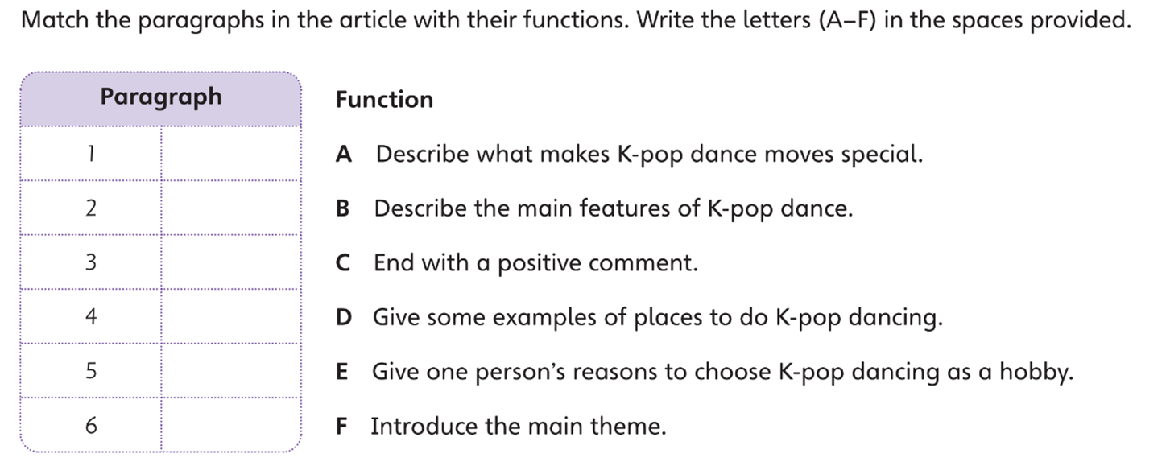
Part A
Part A
Part B
Part C

Slide 4
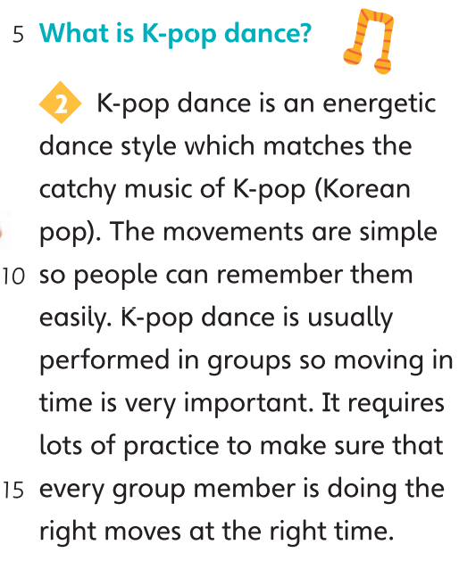
Part A
Part A
Part B
Part C

Slide 5
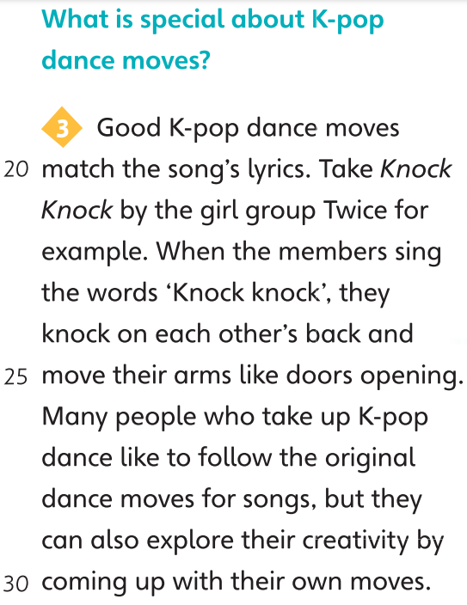
Part A
Part A
Part B
Part C

Slide 6
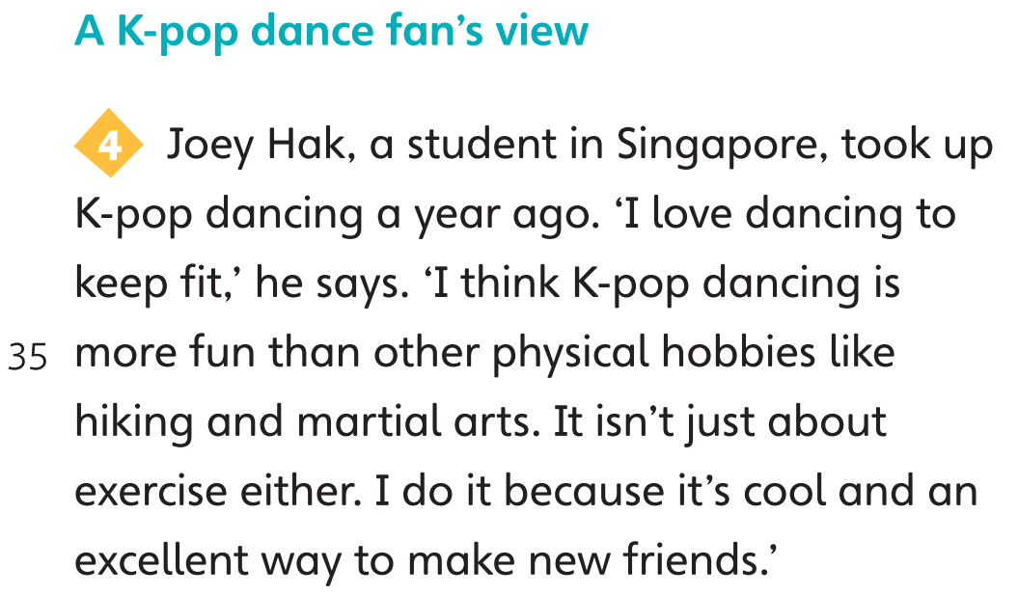
Part A
Part A
Part B
Part C

Slide 7
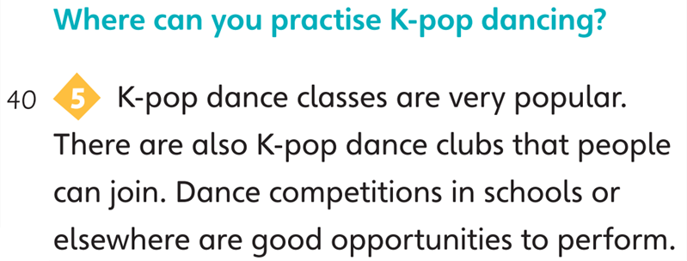
Part A
Part A
Part B
Part C

Slide 8
Part A
Part A
Part B
Part C

Slide 9
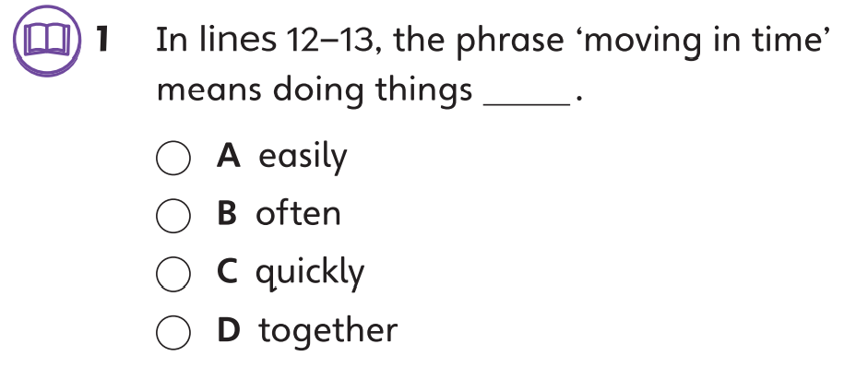
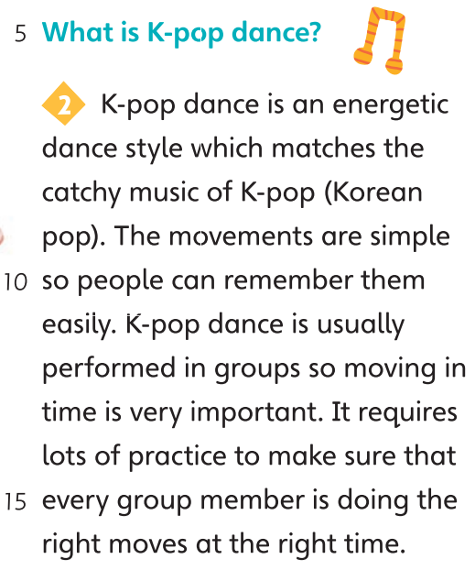
Part B
Part A
Part B
Part C

Slide 10
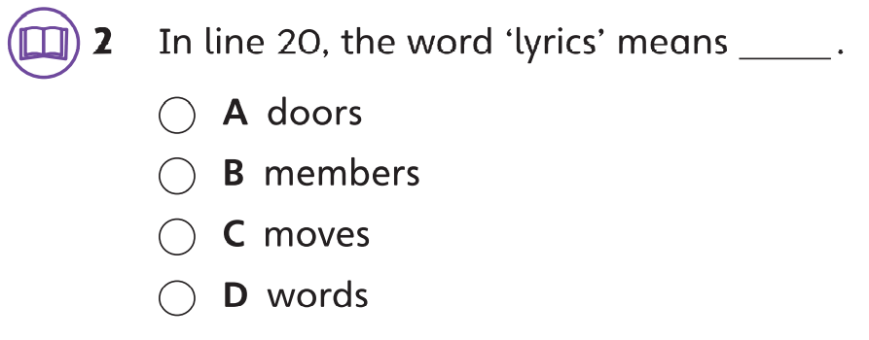
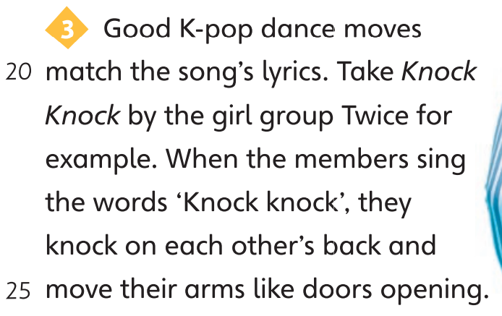
Part B
Part A
Part B
Part C

Slide 11
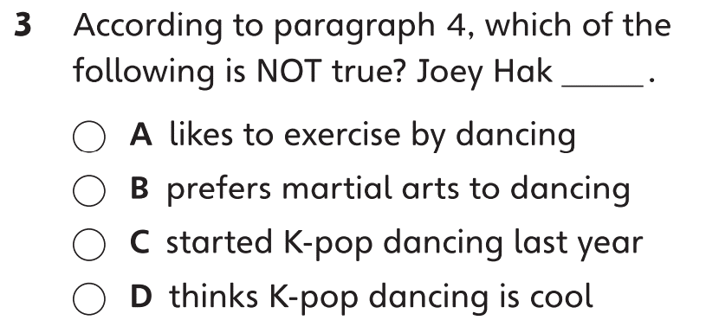
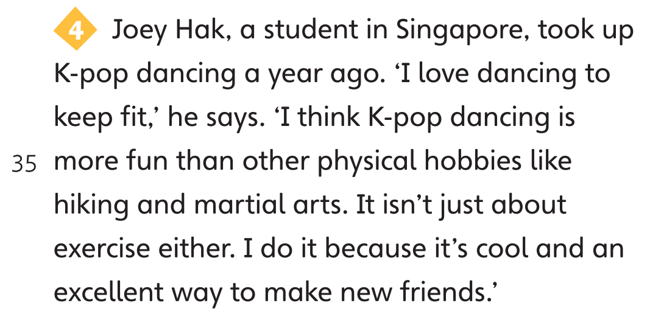
Part B
Part A
Part B
Part C

Slide 12
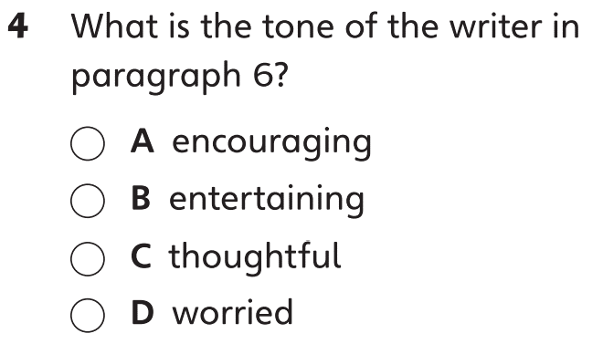
Part B
Part A
Part B
Part C

Slide 13
Part C
Part A
Part B
Part C

Slide 14
Part C
Part A
Part B
Part C

Slide 15
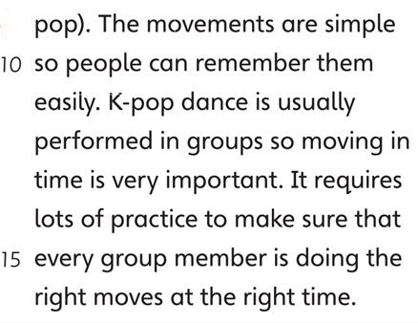
Part C
Part A
Part B
Part C

Slide 16
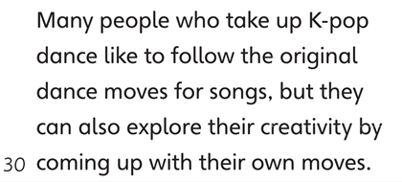
Part C
Part A
Part B
Part C

Slide 17
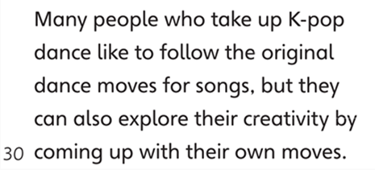
Part C
Part A
Part B
Part C

Slide 18
Part C
Part A
Part B
Part C

Slide 20
Acknowledgments
We are grateful to the following for permission to reproduce copyright photographs:
Anastasiia Cherviak. Shutterstock
Every effort has been made to trace copyright, but in the event of any accidental infringement, we shall be pleased to come to a suitable arrangement with the rightful owner.

